Slide 1


Slide 2
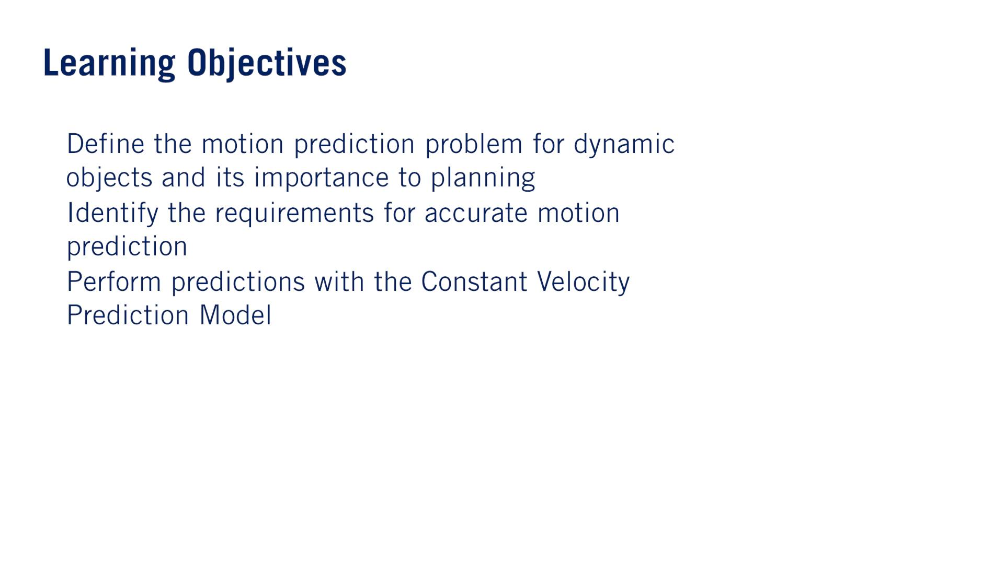
•
•
•
単語
Indicate: When drivers indicate, they make lights flash on one side of their vehicle to show that they are going to turn in that direction.
Warning: A warning is an advance notice（予告） of something that will happen, often something unpleasant or dangerous.
Horizon: Your horizons are the limits of what you want to do or of what you are interested or involved in.

Slide 3
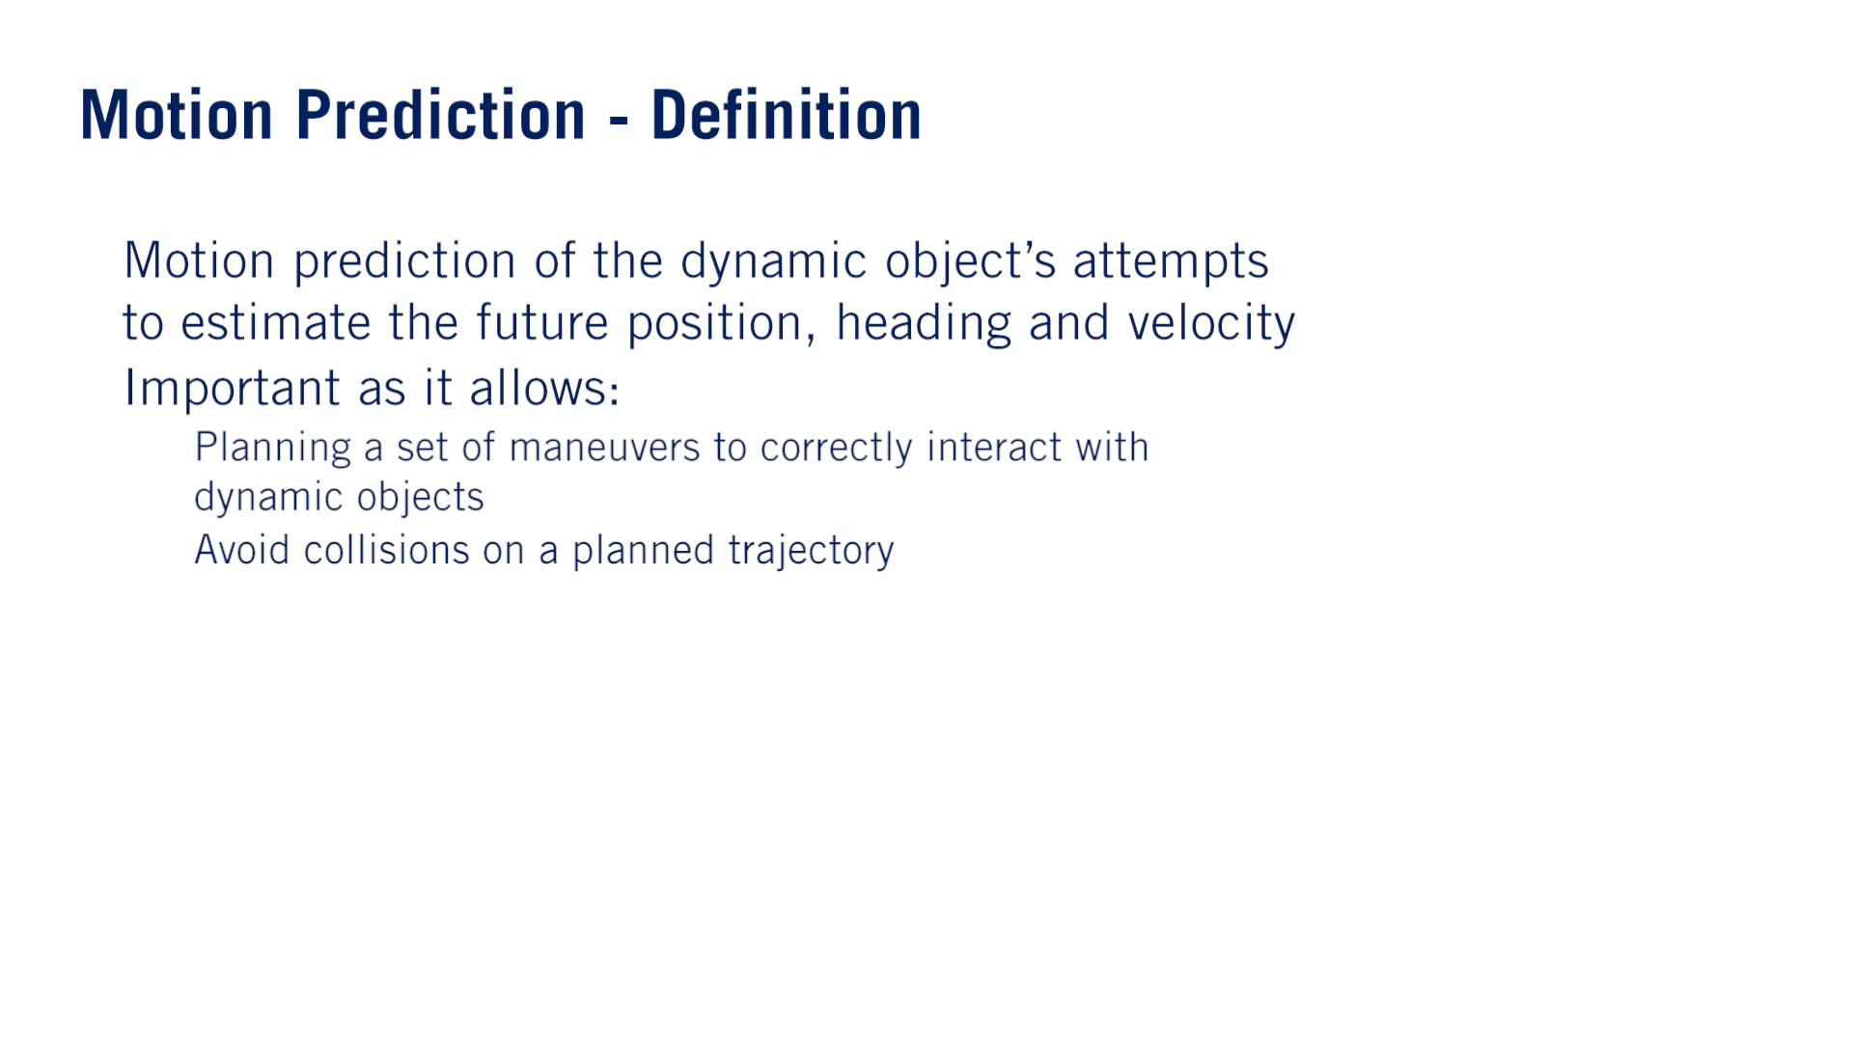
•
•
o
o

Slide 4
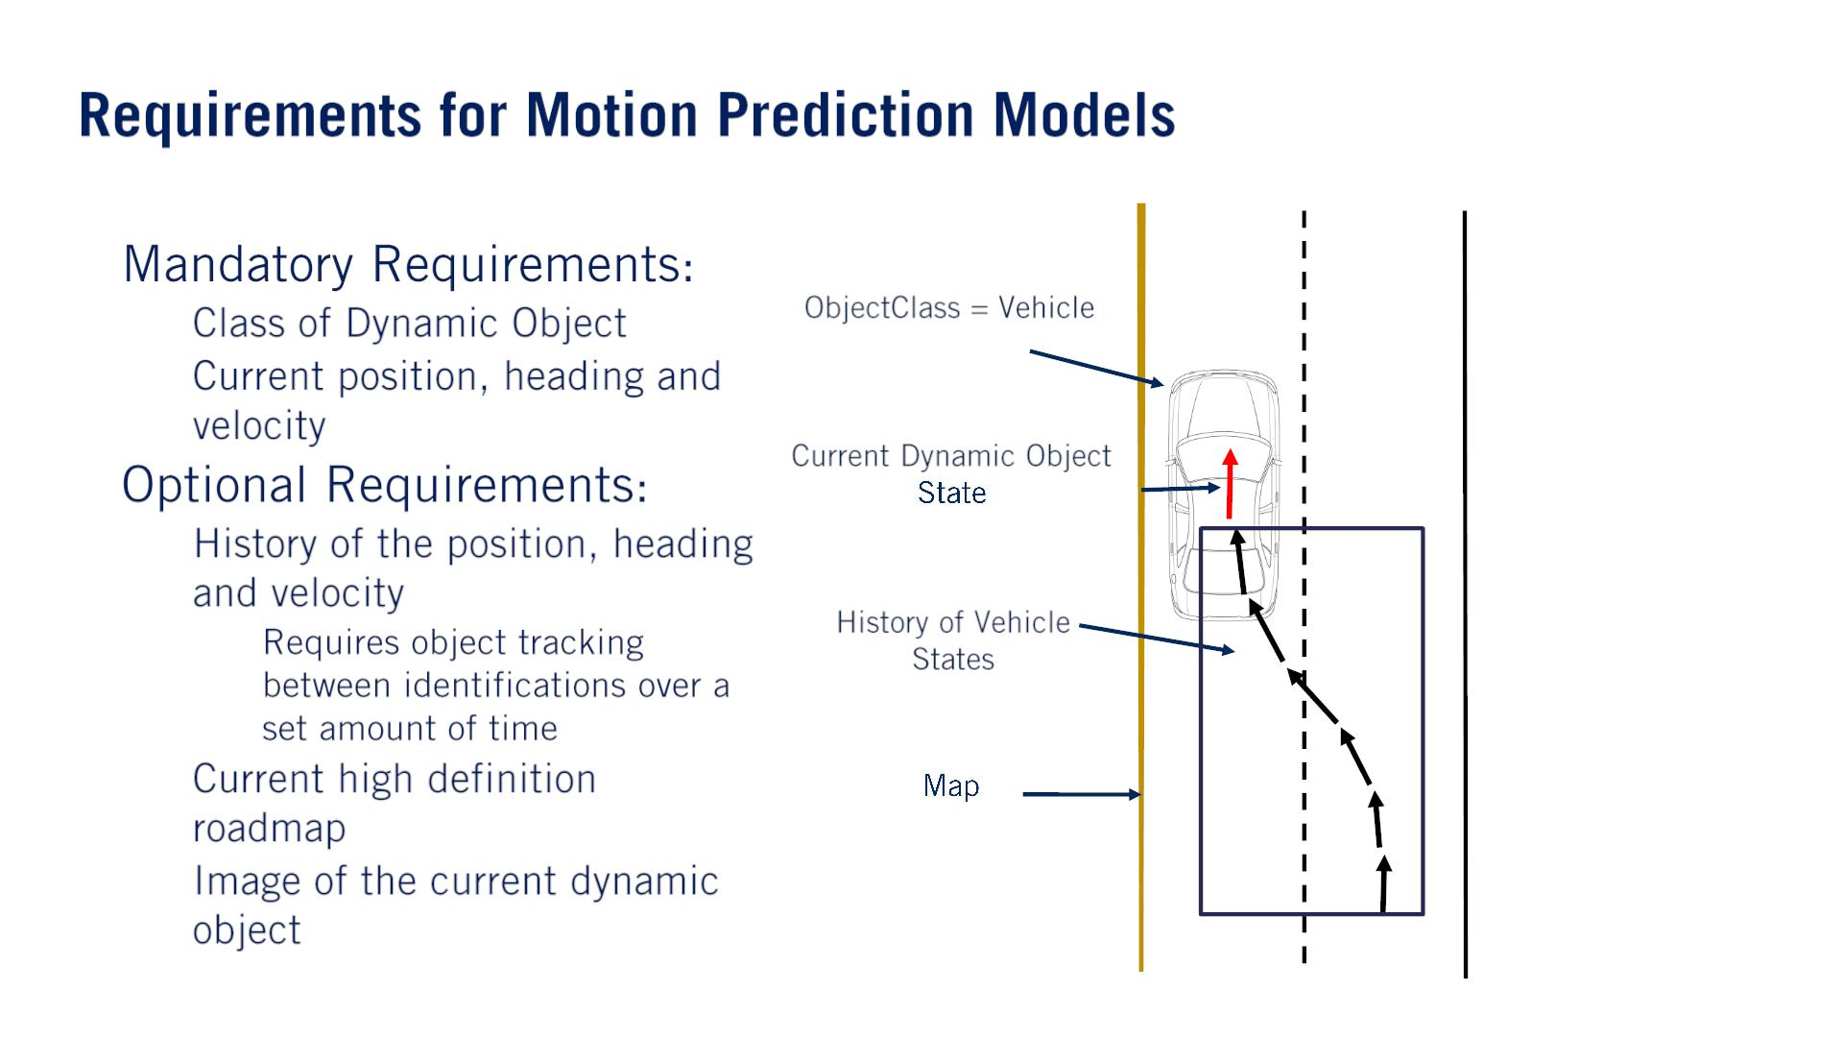
理由：most prediction models have different algorithmic approaches to vehicles as opposed to pedestrians.
•
•
o
o
For vehicles, the image can provide information concerning the current indicator light or brake light states, for example.
For pedestrians, the image can serve to show the current orientation of the person, which can help predict a future direction of travel, even if the pedestrian is currently stationary.
（⼤事）
o
▪
o
o

Slide 5
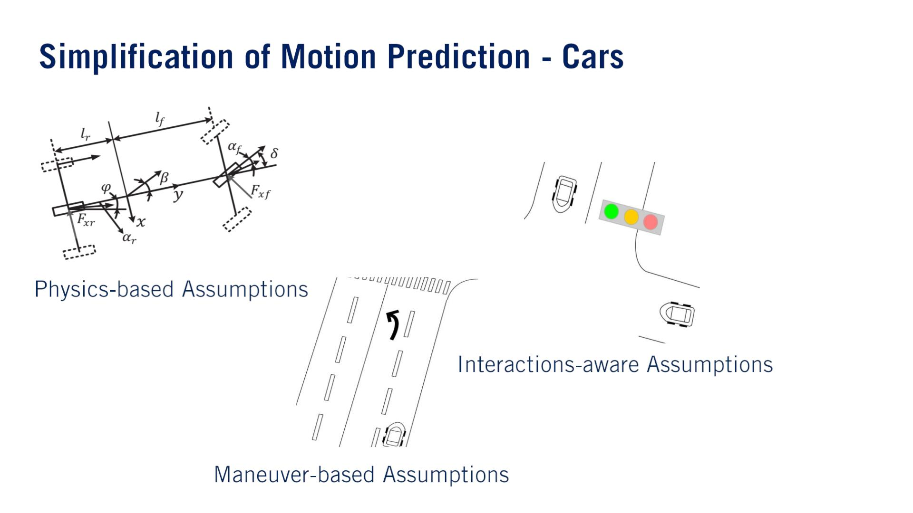
The dynamic objects will react and interact with each other.
An example of this type of prediction, is during a merge by a vehicle into an adjacent lane.
Often, the vehicle in the destination lane will slow down to make more room for the incoming vehicle to maintain a safe following distance.
They will most likely stay in their lane unless indicating otherwise and stop at regulatory elements requiring stops.
They are unlikely to drive over sidewalks or lawns or through obstacles.

Slide 6
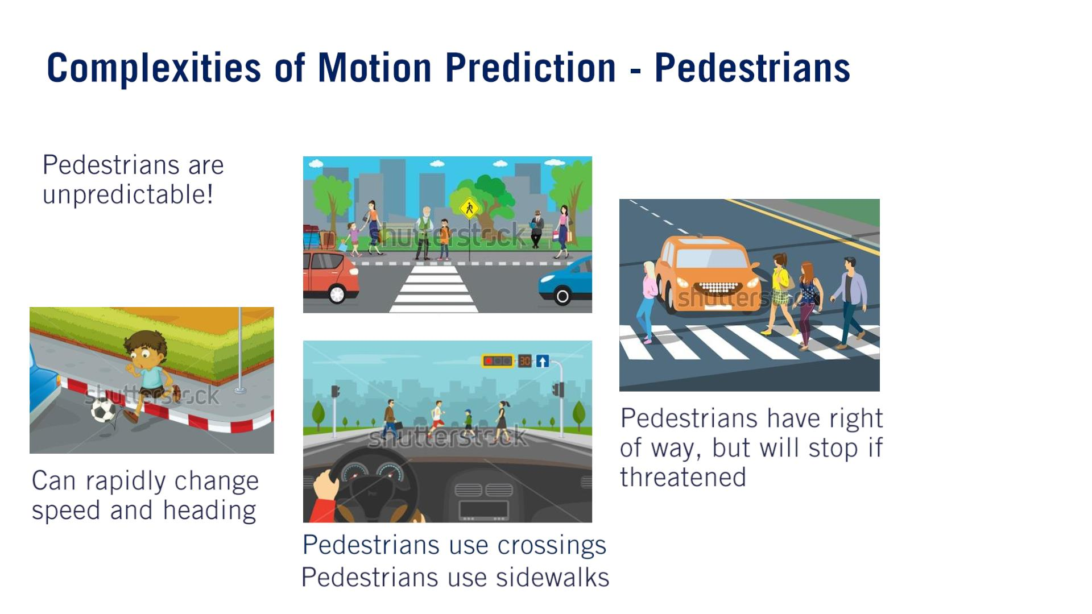
Pedestrians tend not to interact directly with vehicles.
Pedestrians ultimately have the right of way and it is the self-driving cars duty to stop when necessary.
どんな状況でも⼈の優先度は⾞より⾼い！
Inattentive pedestrians may wander into a roadway without warning, but will often stop when threatened by an oncoming vehicle.
The range of positions a pedestrian can reach in a short time frame is limited.

Slide 7
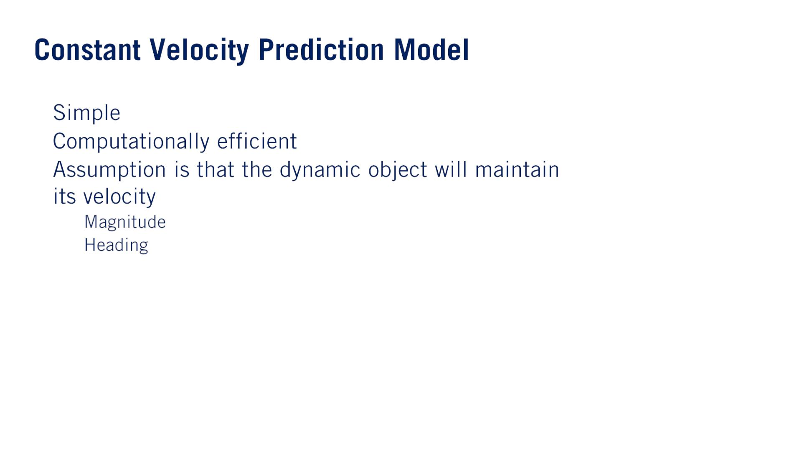
•
•
•
o
o

Slide 8
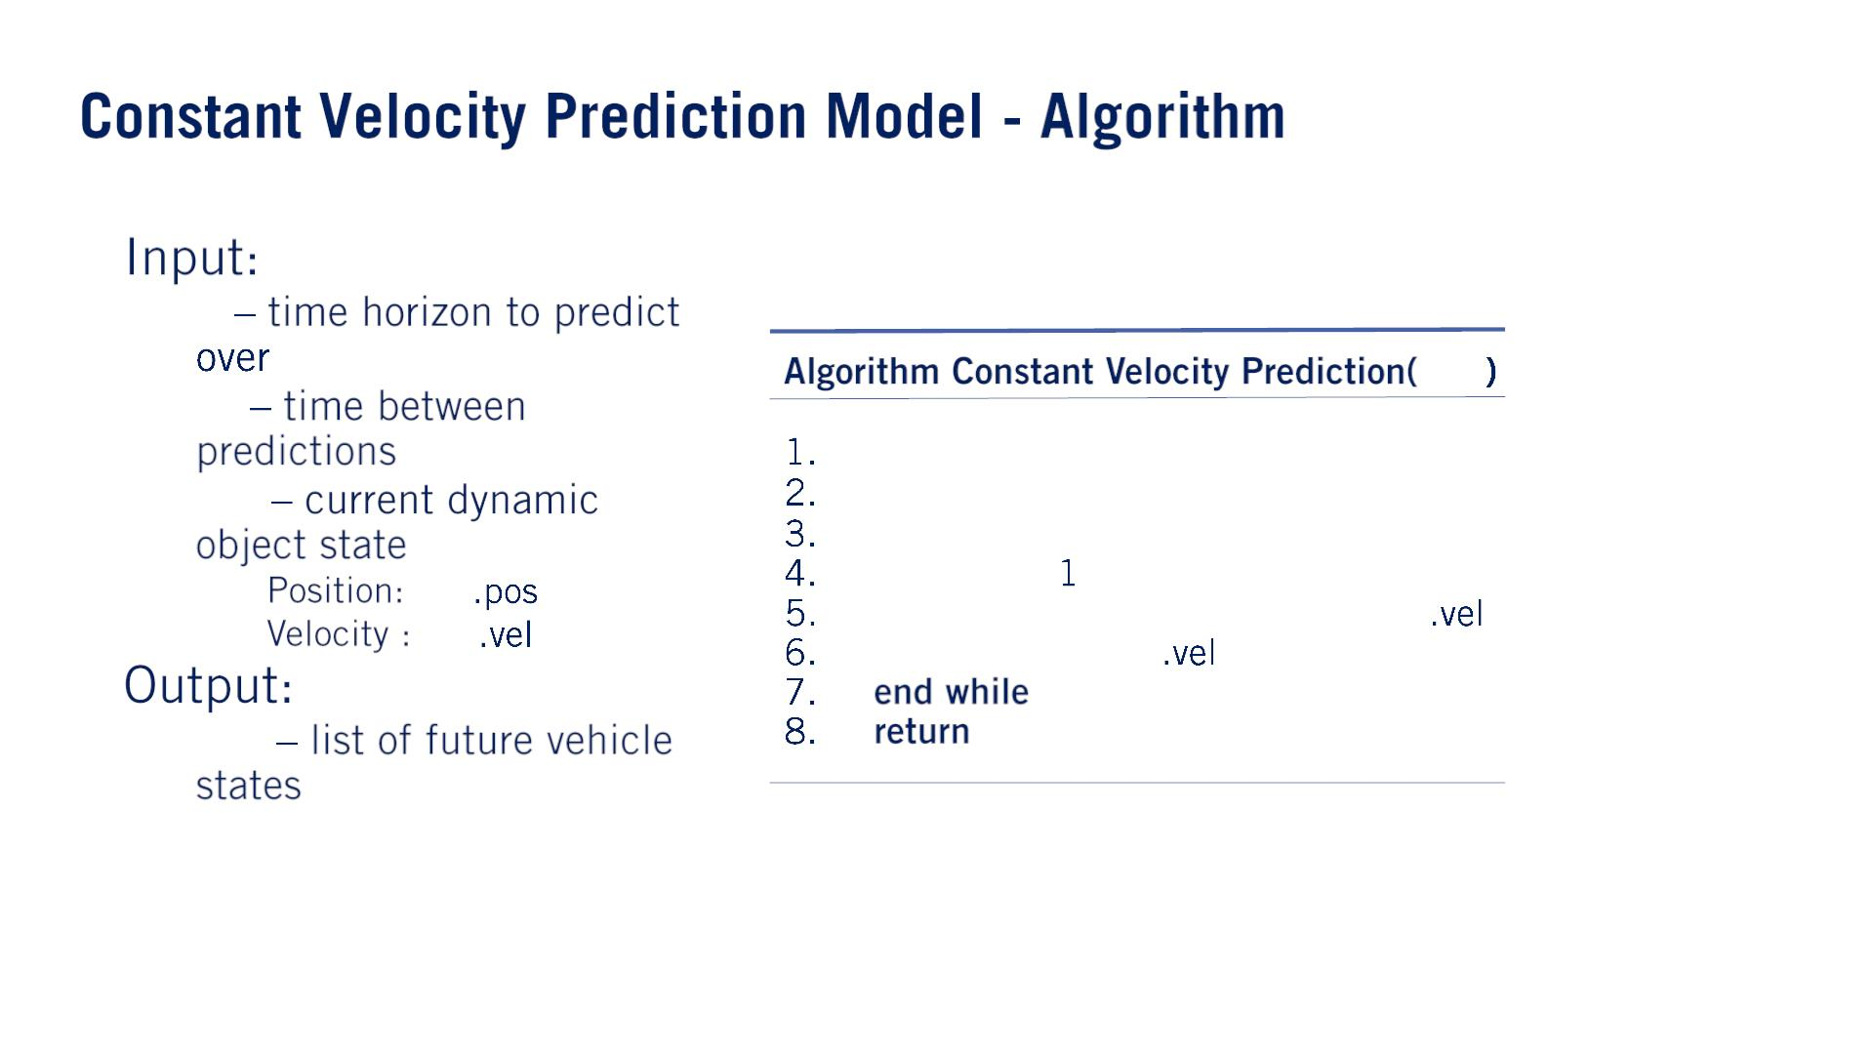
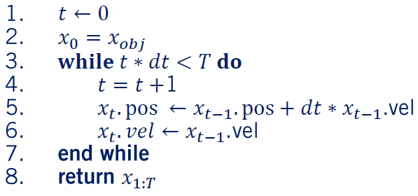
•
•
o 푇
^{푥}표푏푗
o 푑푡
o 푥_{표푏푗}
▪
▪
푥_{표푏푗}
푥_{표푏푗}
o 푥_{1:푇}

Slide 9
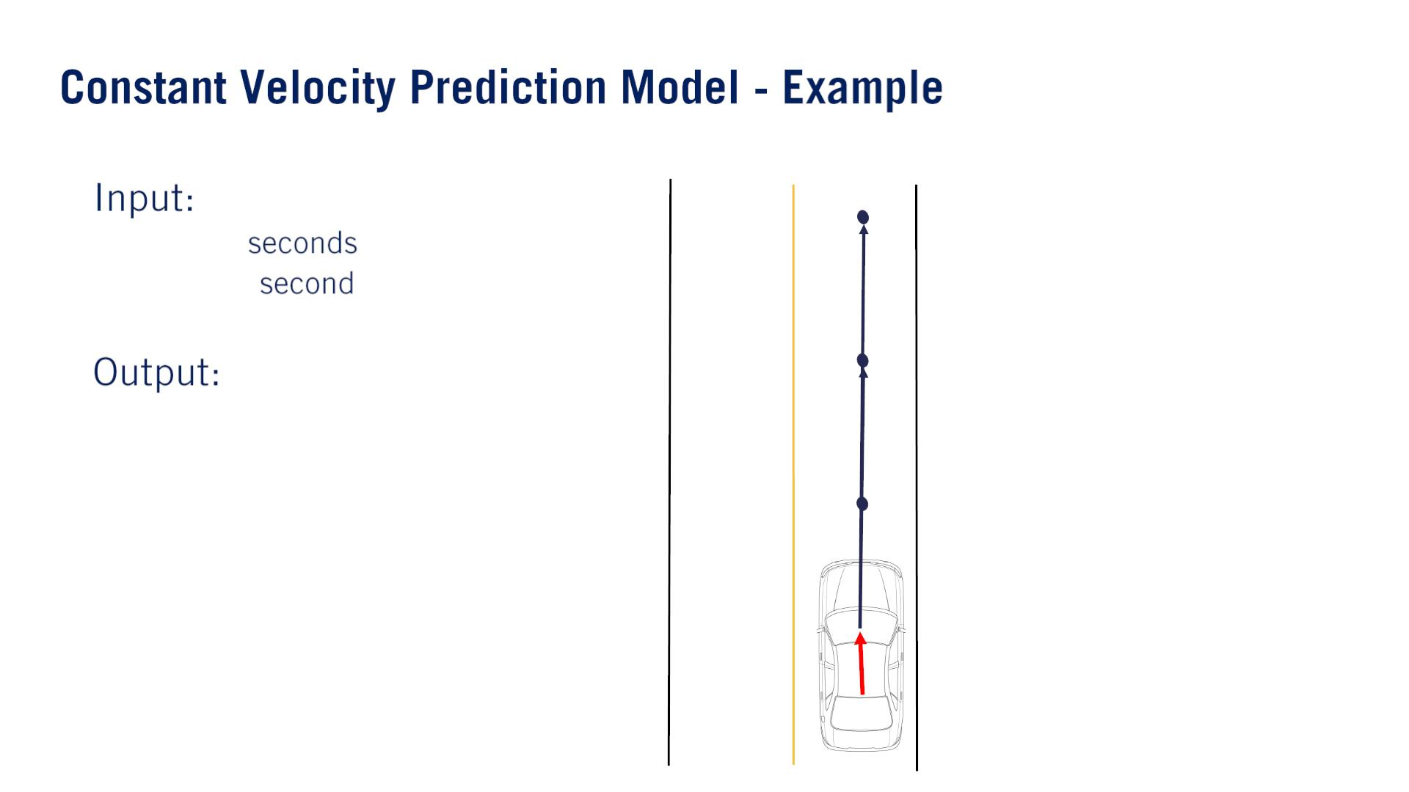
•
•
x₃
푇 = 3푠
o 푇 = 3
o 푑푡 = 1
o 푥_{표푏푗}
^{x}2
o 푃푟푒푑푖푐푡푖표푛푠
x₁
x₂
x₃
x₁
t = 1s

Slide 10
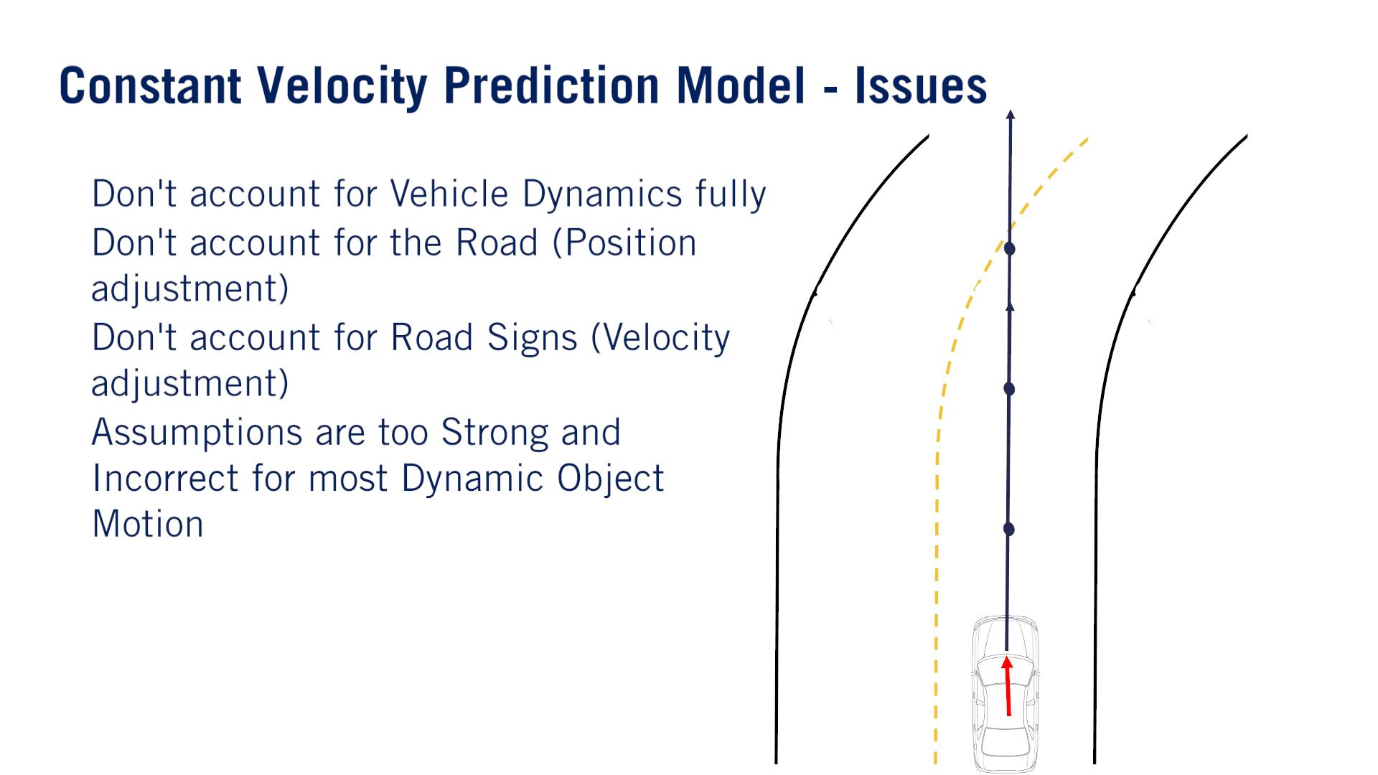
straight line segmentにのみOK. Where the constant velocity estimate fails, however, is everywhere else. weakly falls into the category of physics-based assumptions.
•
•
•
•
Vehicles approaching stop signs tend to slow down and vehicles leaving a stop line tend to accelerate.

Slide 11
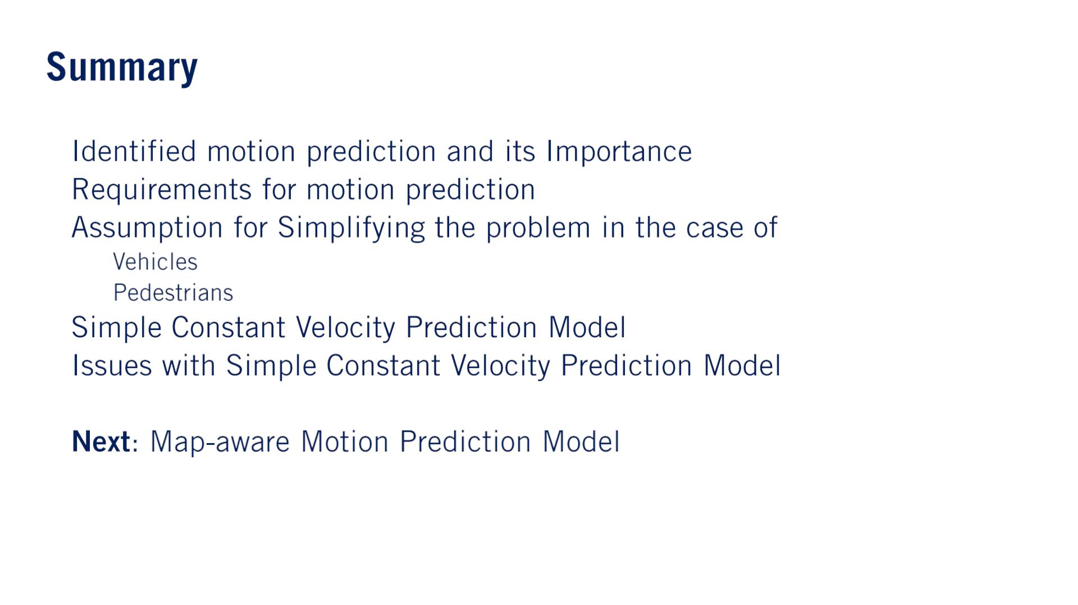
•
•
•
o
o
•
•
•

Slide 12
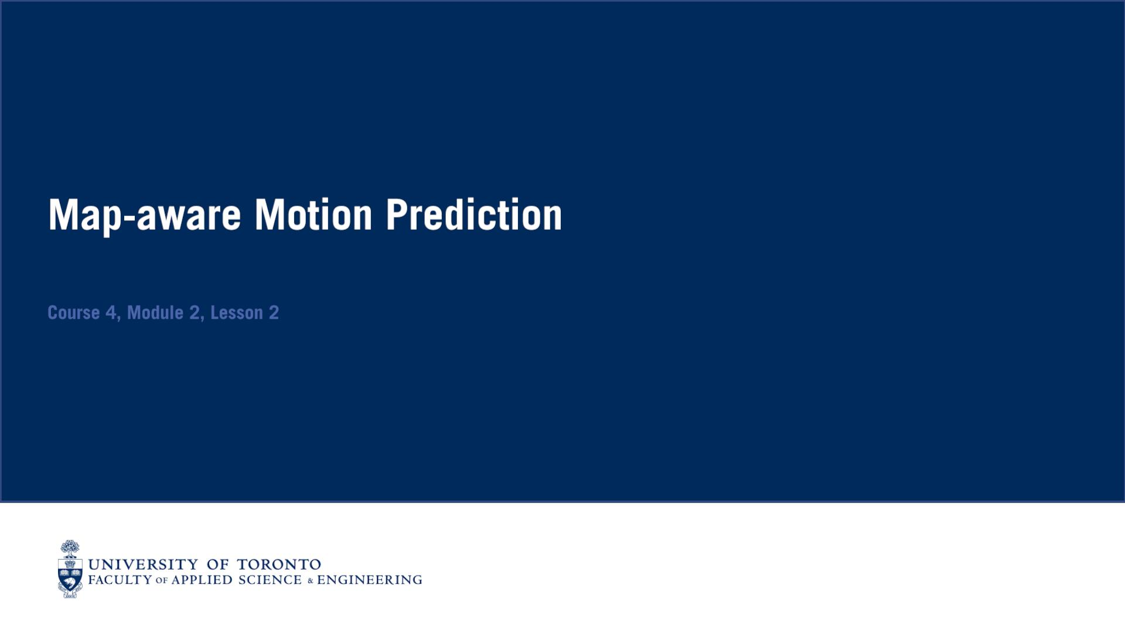

Slide 13
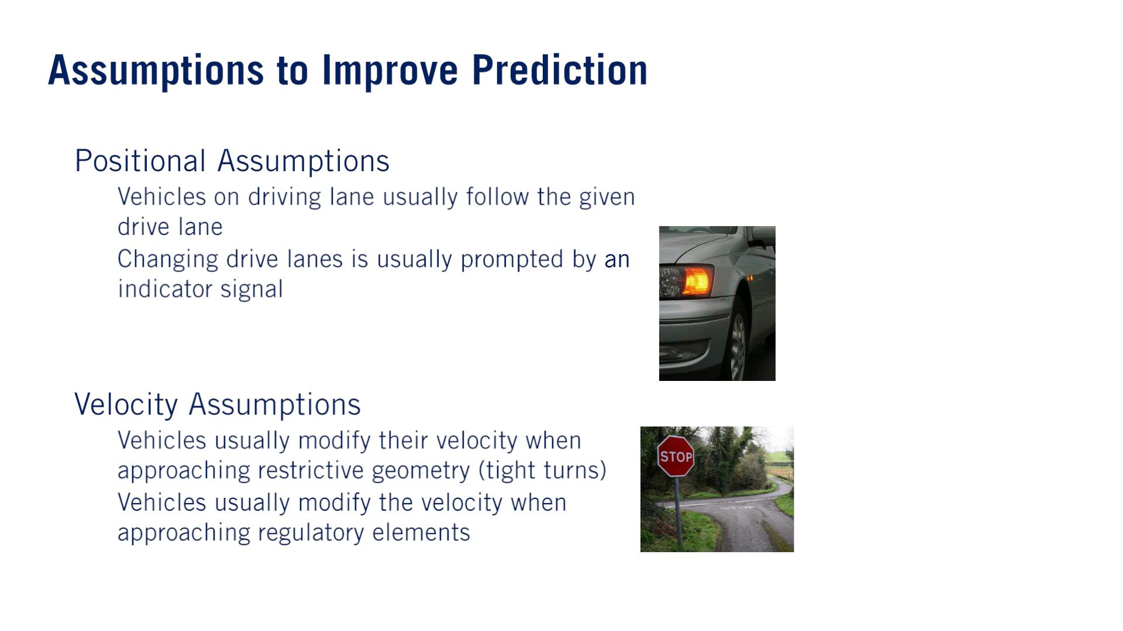
•
•
o
o
Important to understand that the more constraints or assumptions that are added to a prediction model, the less generalizable it can be to all traffic scenarios.
In fact, there are cases where even these generic assumptions can be overly constraining.
なぜpositional assumptionという名前？This is possible if the other vehicle is in a position to perform a lane change in the map.
o
o
規制

Slide 14
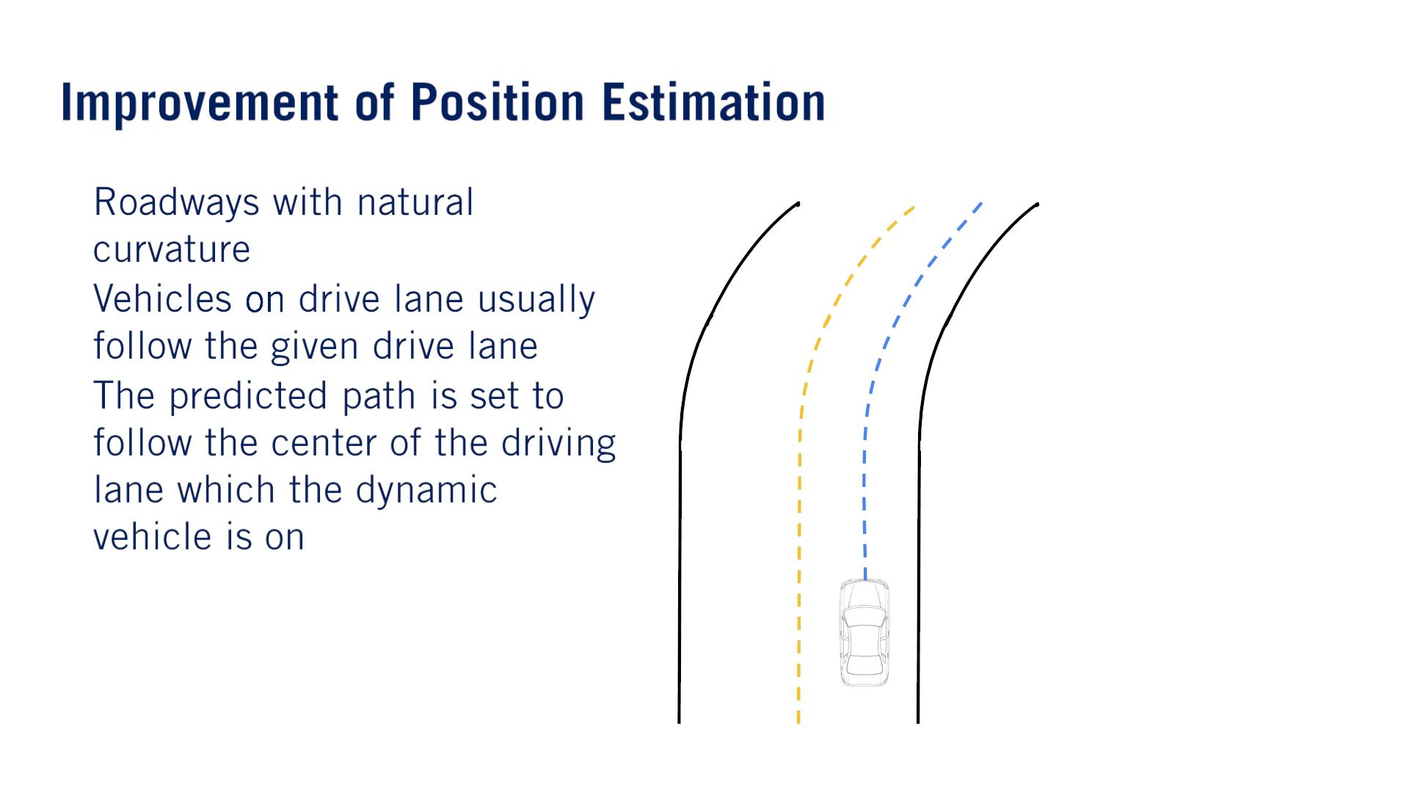
•
•
•

Slide 15
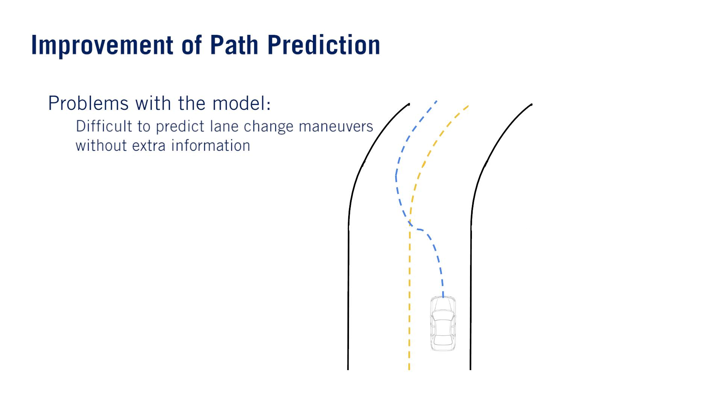
•
o

Slide 16
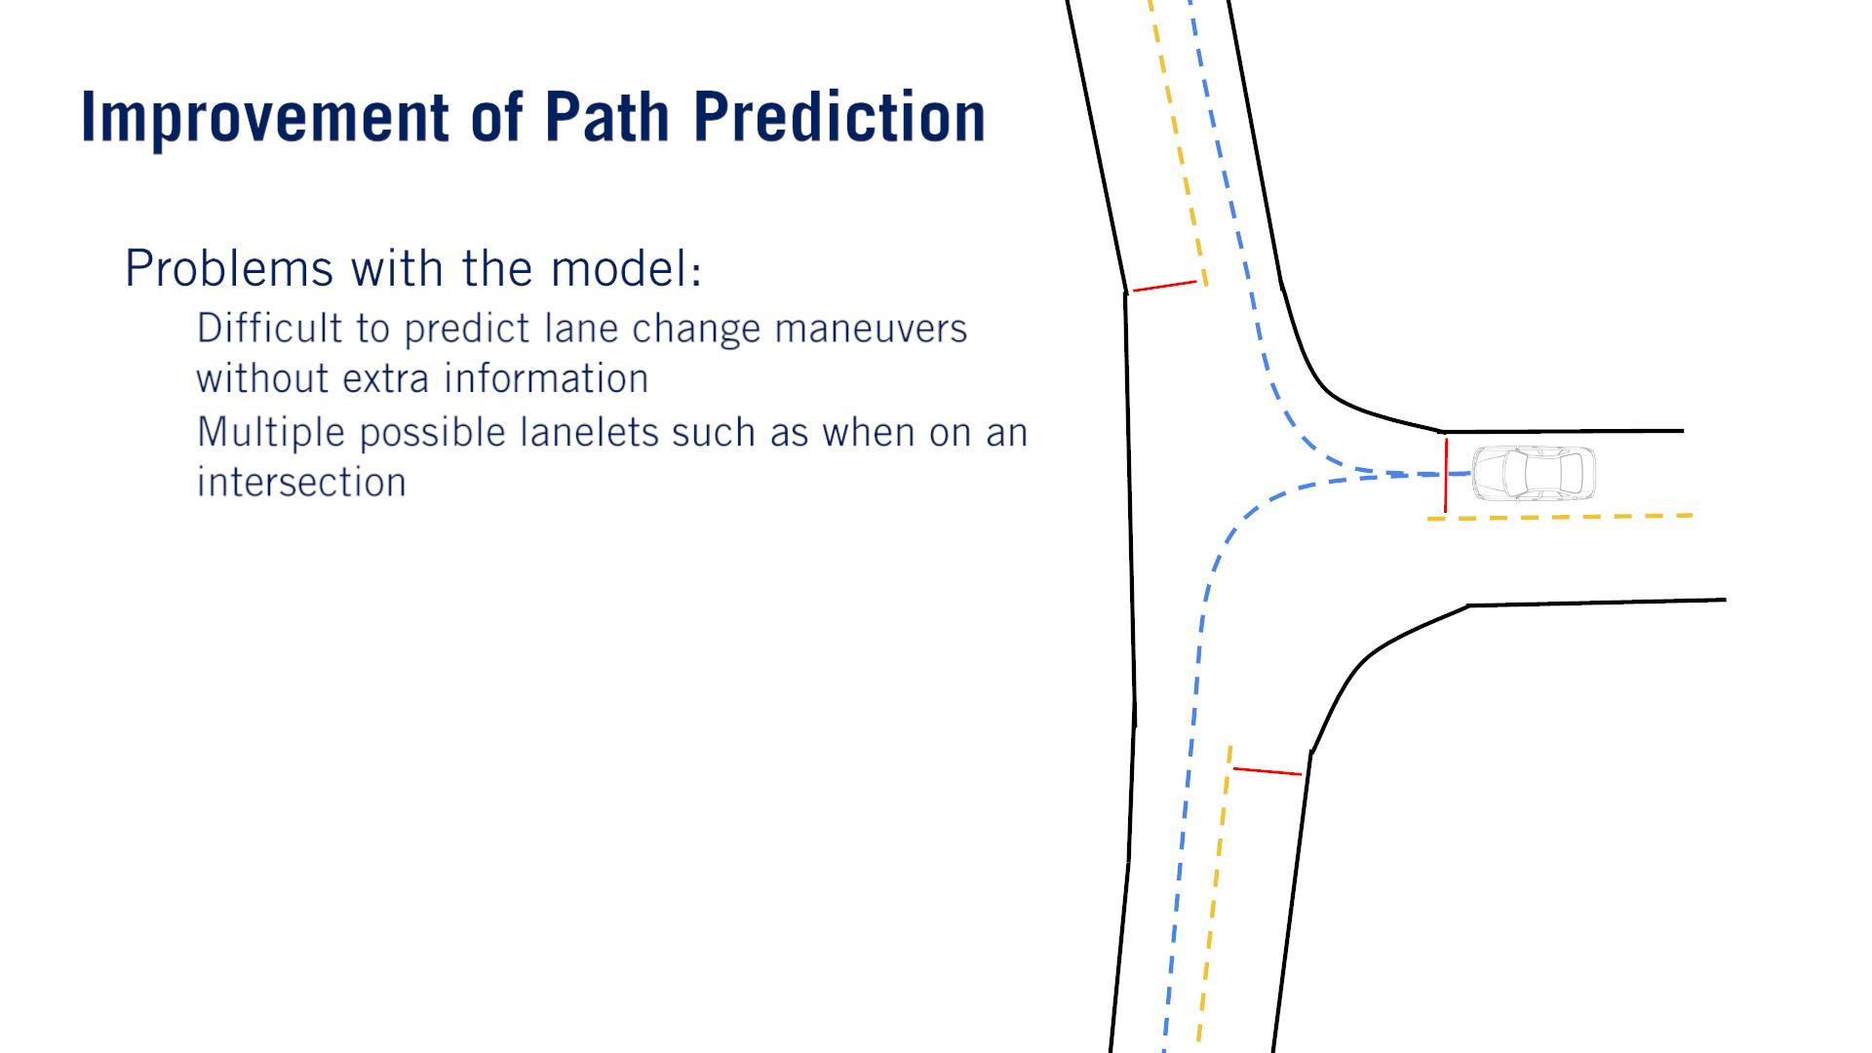
•
o
o

Slide 17
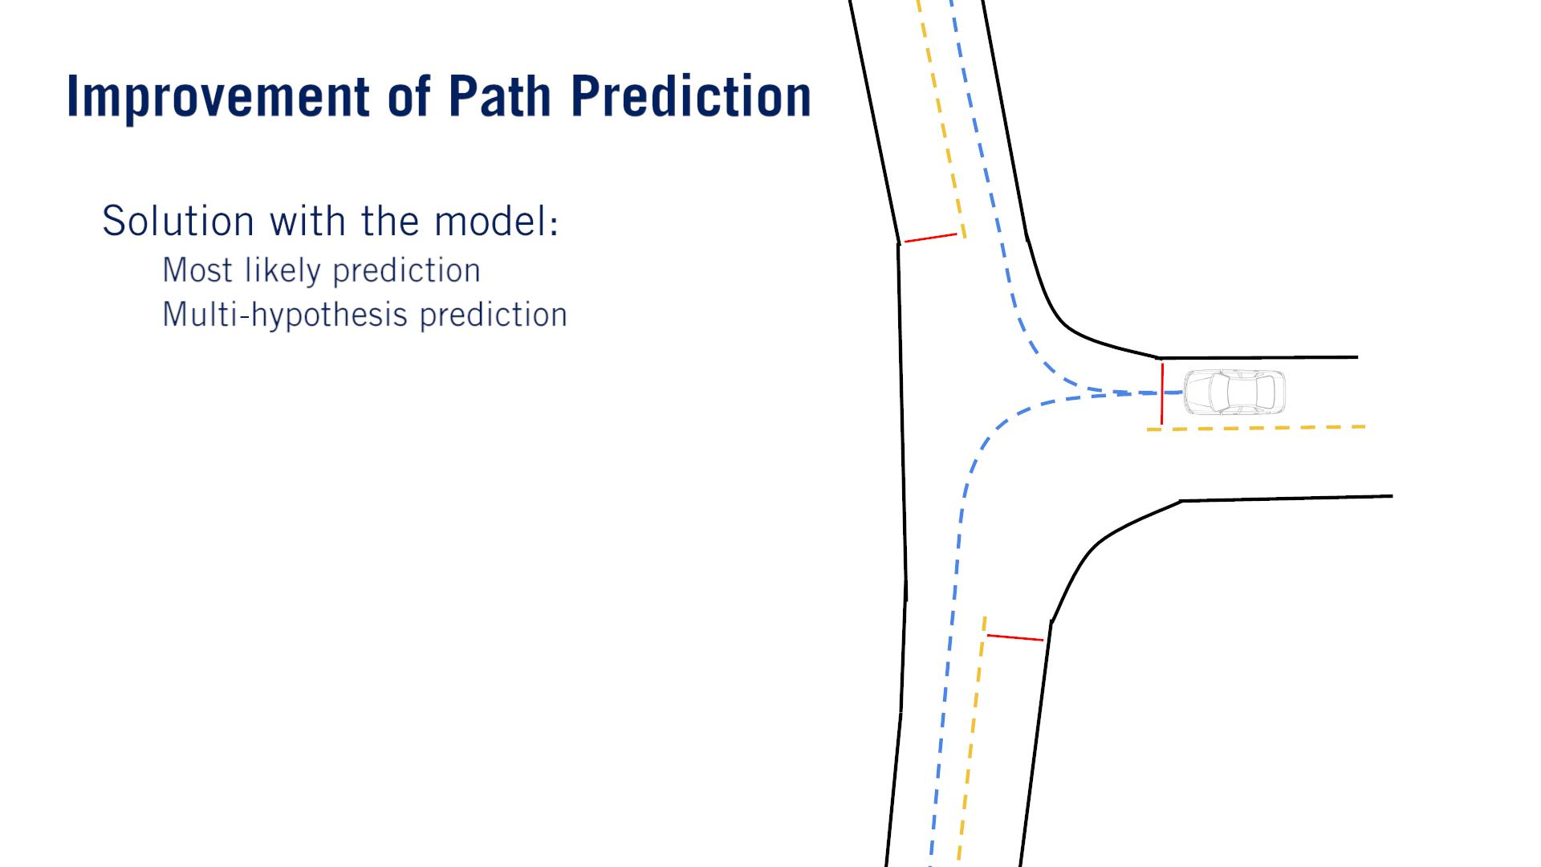
•
o
o
Construct a prediction for the most likely behaviors and associate a probability that the agents will follow a particular path based on the state, appearance and track information.
最近読んだDeep Learningベースの車両行動予測サーベイ論文の、Uni-modalやMulti-modal trajectoryと対応するみたい。

Slide 18
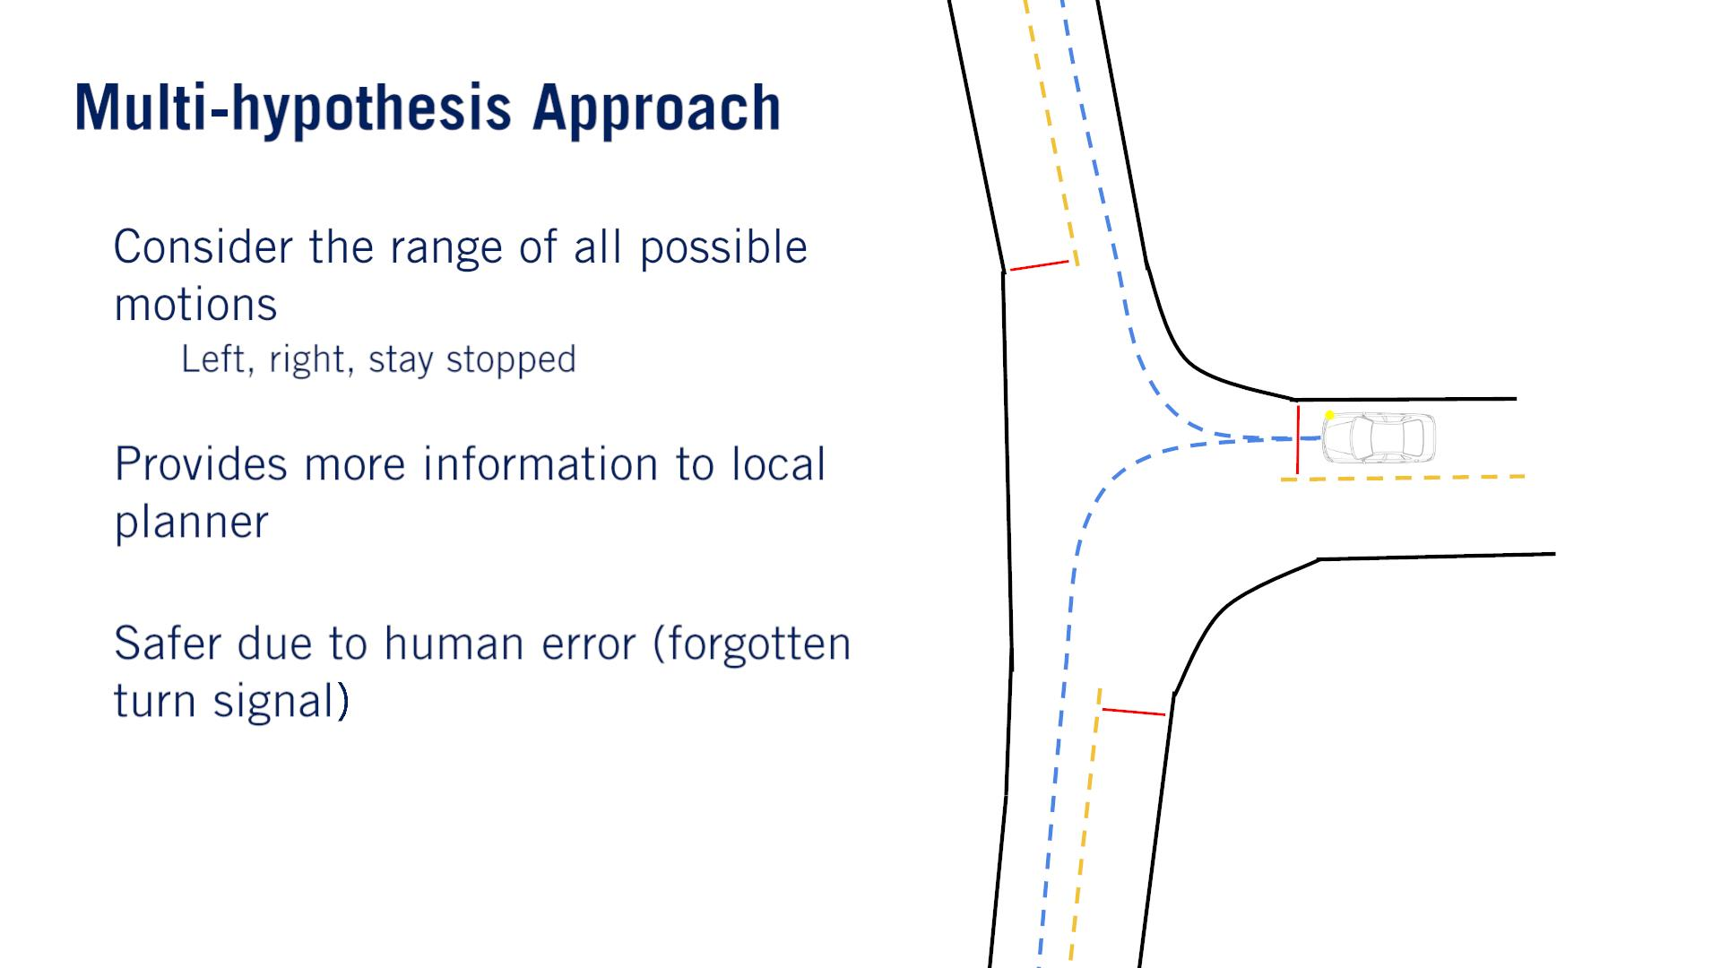
•
o
•
•
Such approaches traditionally provide more ambiguous information to the behavior planner.
Based on corroborating（確証する） evidence such as indicator signals, position to the left or right of the center line, and the state, of the vehicle at the intersection.
These probabilities can be learned from training data of many vehicles proceeding through similar intersections, or can be engineered and refined from real-world testing.

Slide 19
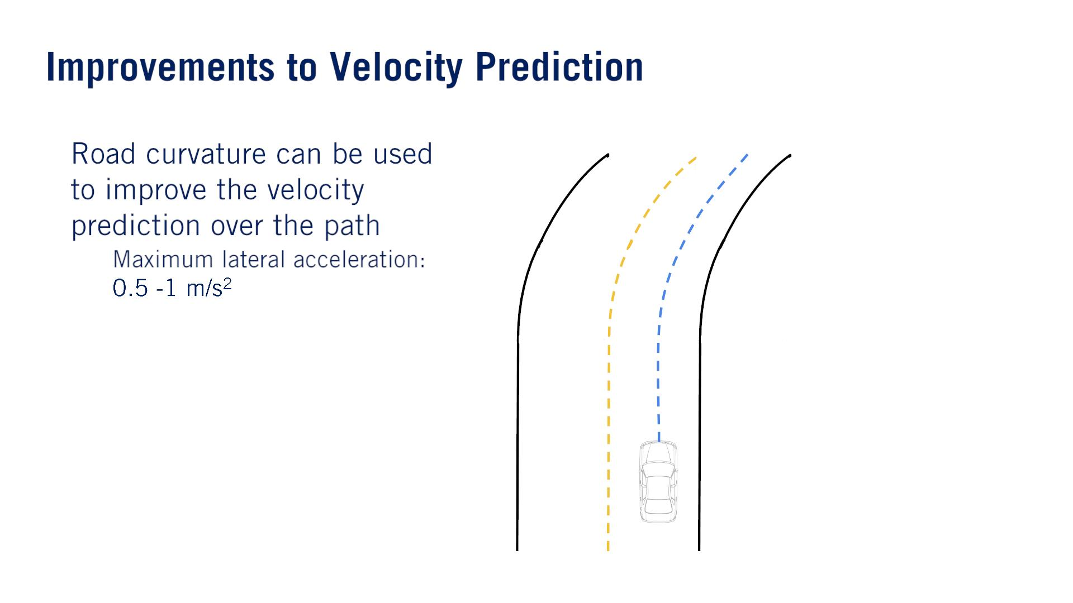
•
o

Slide 20
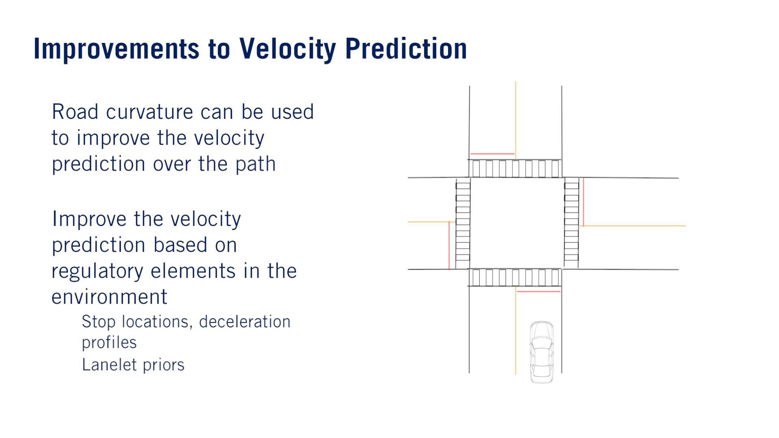
•
•
o
o
Given a HD road map, it is possible to preprocess the map for nominal trajectories along each roadway, and to define lanelet specific multi-hypothesis priors, based on nominal driving behavior.
This serves both as guidance for the ego vehicle in planning its behaviors and trajectories, and also in terms of refining the motion predictions for other agents.

Slide 21
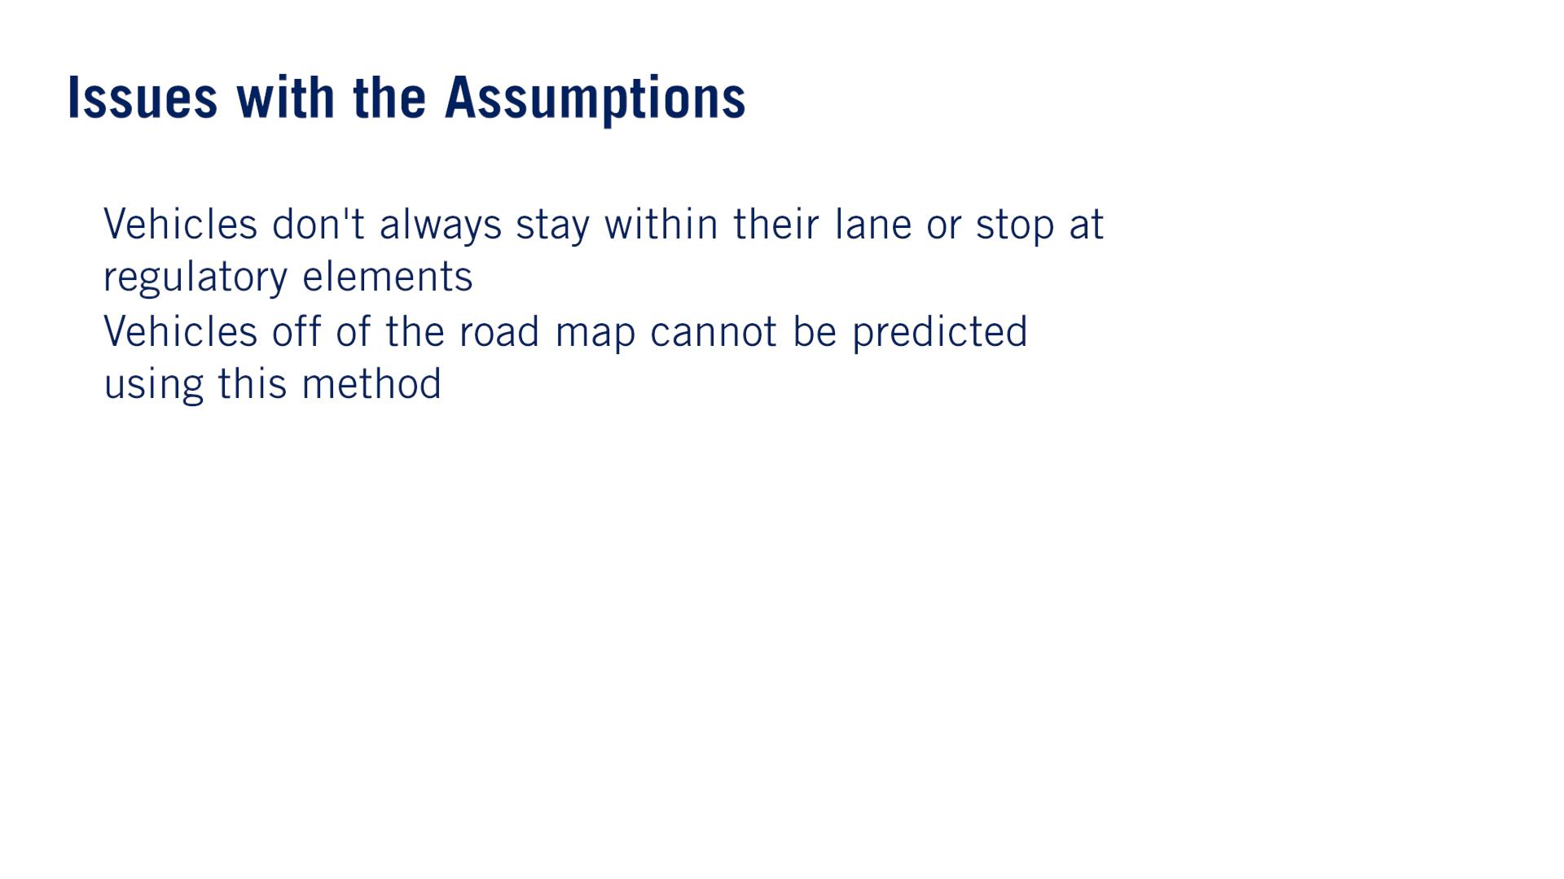
•
•
such as a pothole in the road ahead or a bouncing ball.
The best approach is therefore to track the evolution of beliefs over the set of hypotheses, and to update based on evidence from the perception stack at every time step.

Slide 22
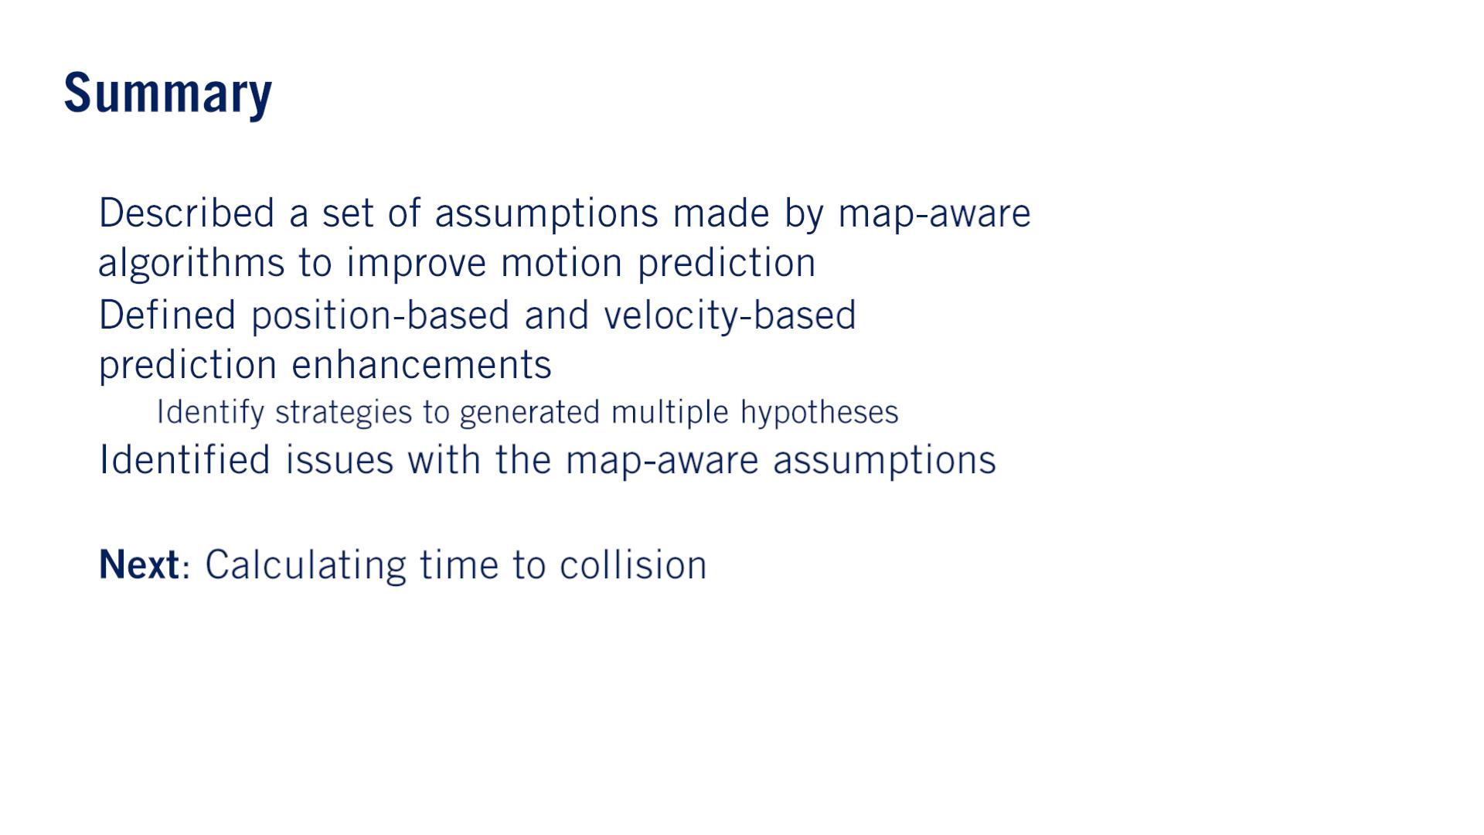
•
•
o
•
•

Slide 23


Slide 24
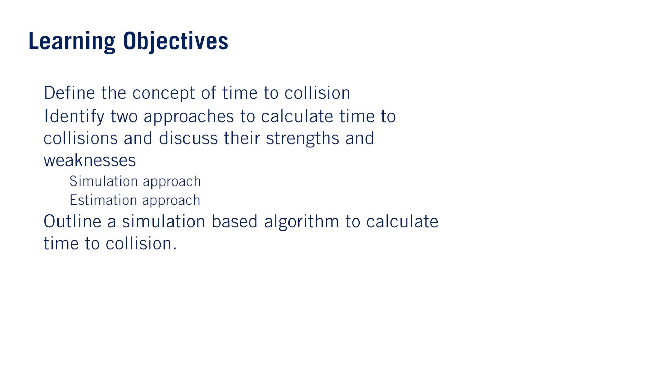
•
•
o
o
•
単語
Evasive: If you take evasive action, you deliberately move away from someone or something in order to avoid meeting them or being hit by them.
Geometry: The geometry of an object is its shape or the relationship of its parts to each other.
Memory Footprint: Memory footprint refers to the amount of main memory that a program uses or references while running.
Implication: The implications of something are the things that are likely to happen as a result.
Bumper: Bumpers are bars at the front and back of a vehicle that protect it if it bumps into something.

Slide 25
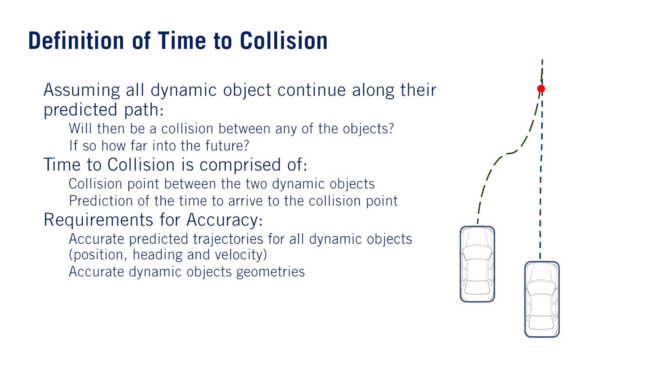
3.24 Sec
•
o
o
•
•
o
o
o
o
Due to errors in both requirements, the time-to-collision should always be treated as an approximation, updated regularly, and treated with some safety buffer when making decisions about driving.

Slide 26
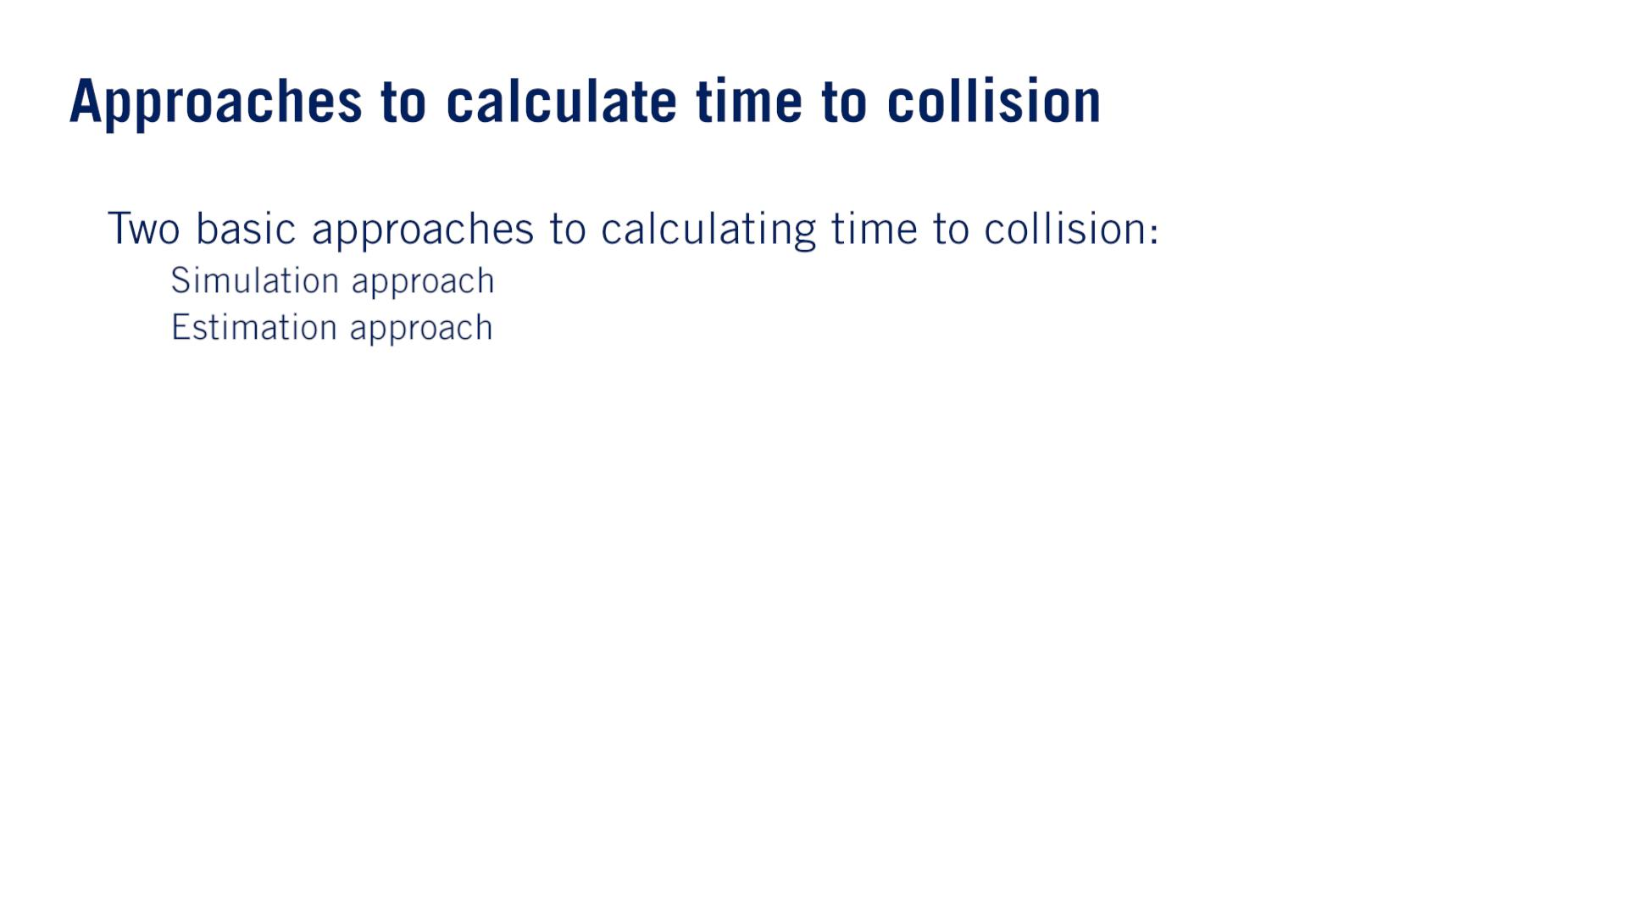
•
o
o

Slide 27
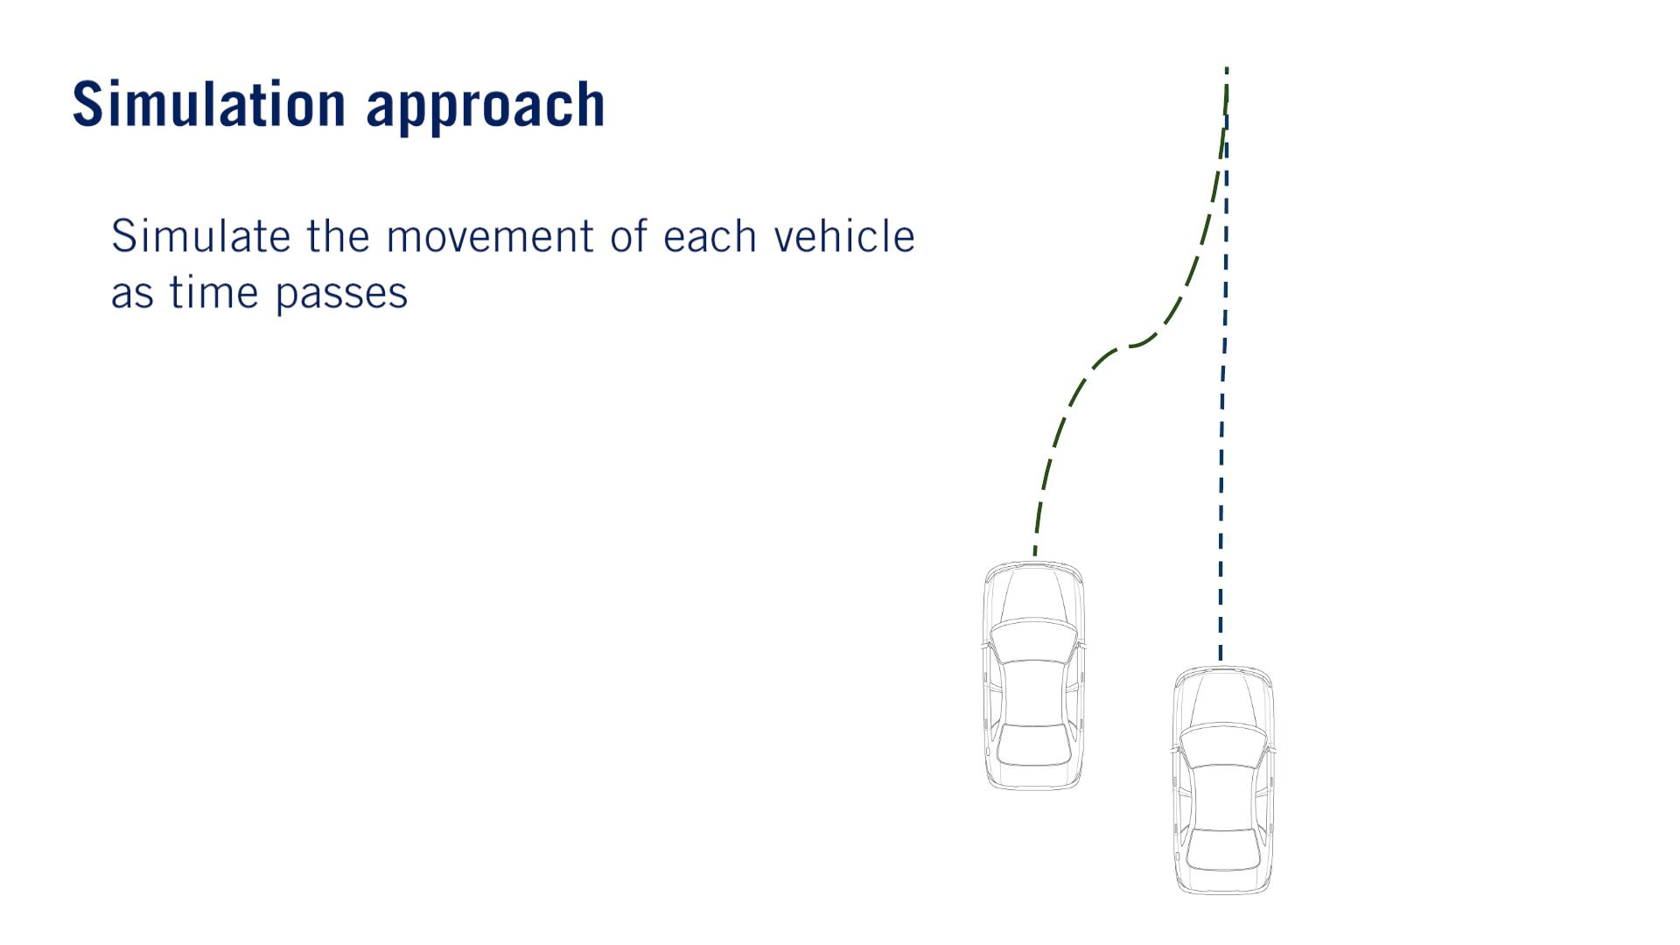
•

Slide 28
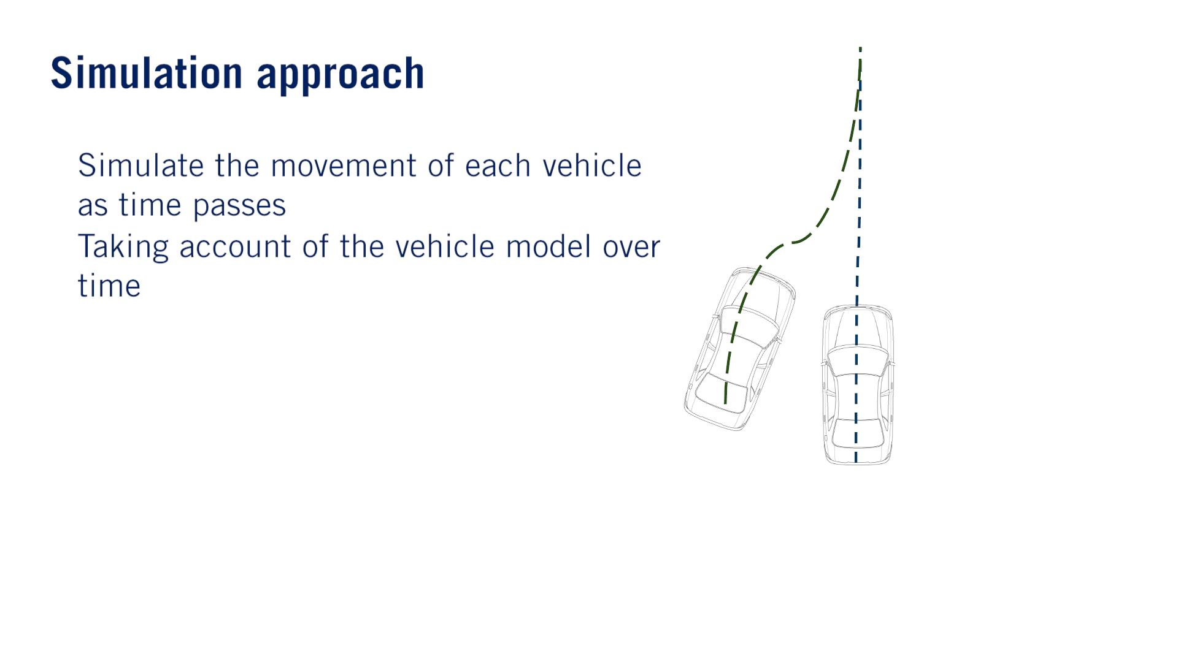
•
•

Slide 29
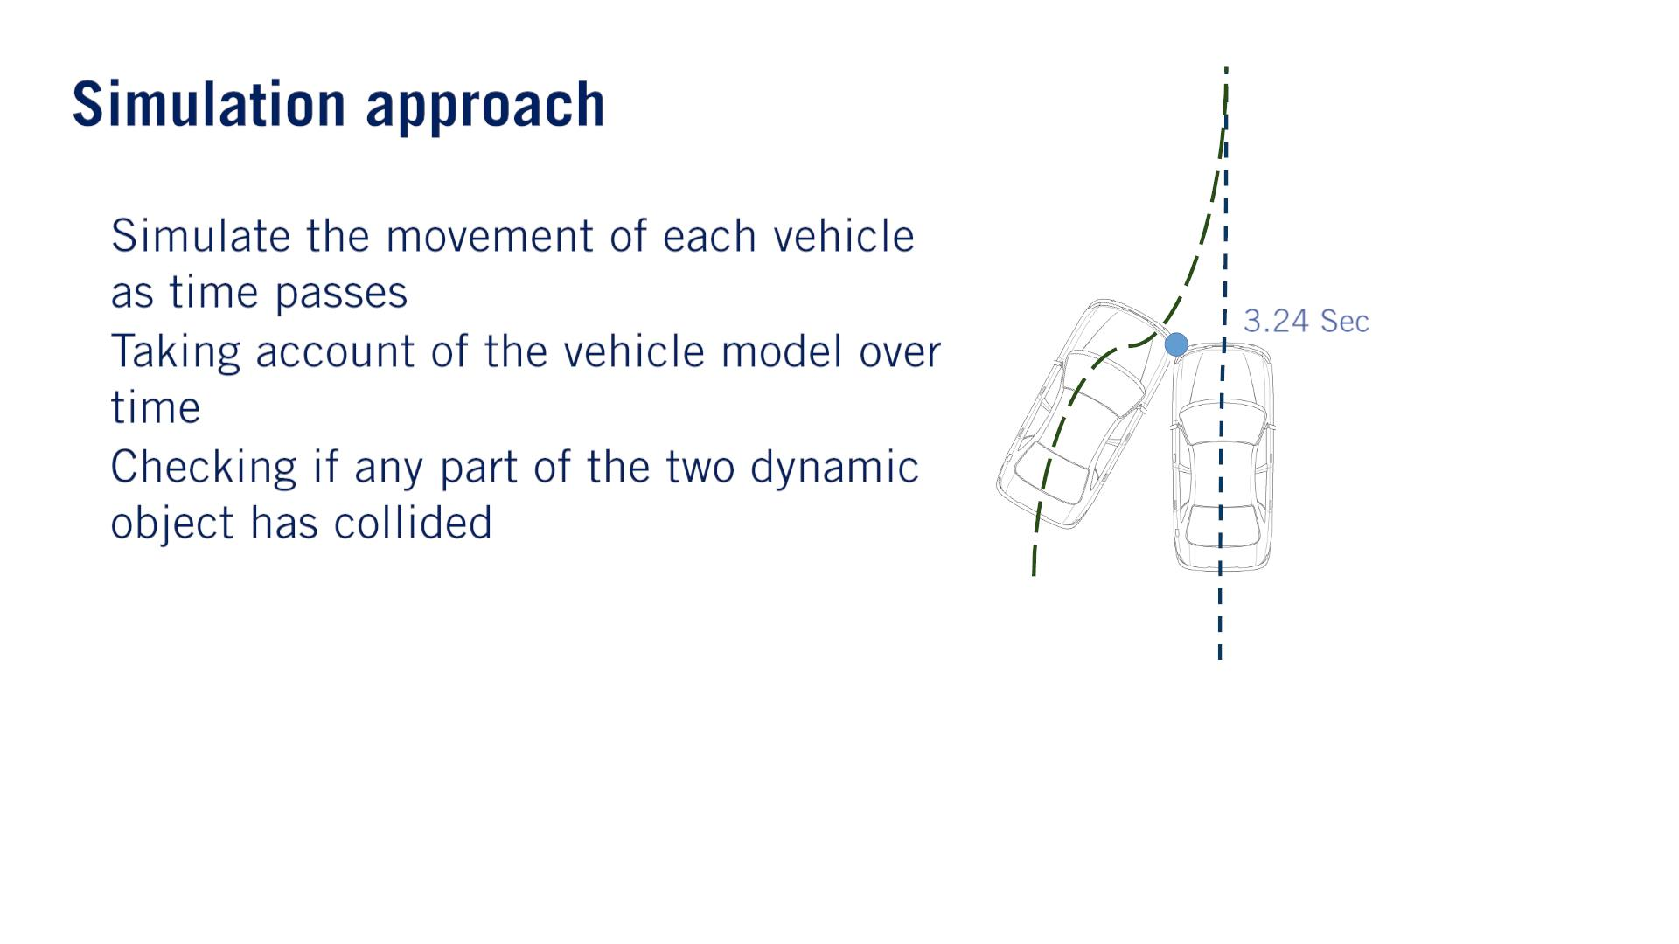
•
•
•
Note that this is a different type of collision checking than in the static case, where swaths of the entire path were constructed and compared to static object locations（Occupancy Grid Mapのやり⽅）.
Because these collision checks are performed between moving objects, we only need to check collision between the geometries of each object at each instant, as the objects will occupy new locations at the next time step.

Slide 30
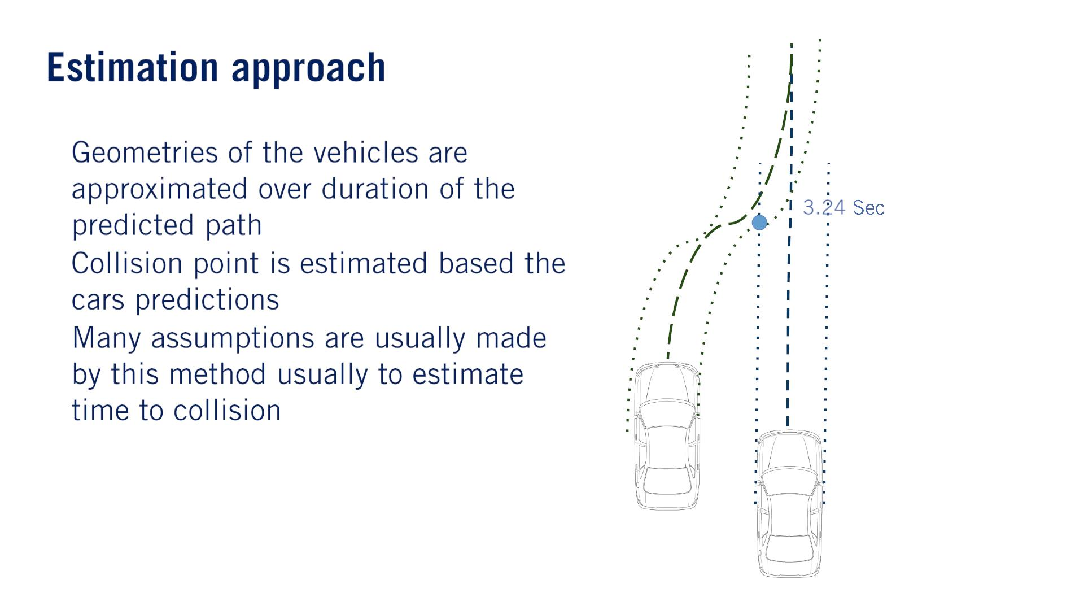
•
•
•
Once the swath has been computed, their intersection can be explored for potential collision points by computing, if any two or more dynamic objects will occupy the same space at the same time.
Simplifying Assumptions.
identifying collision point locations based on object path intersection points.
estimating object space occupancy based on simple geometric primitives like bounding boxes.
estimating the time to a collision point based on a constant velocity profile.

Slide 31
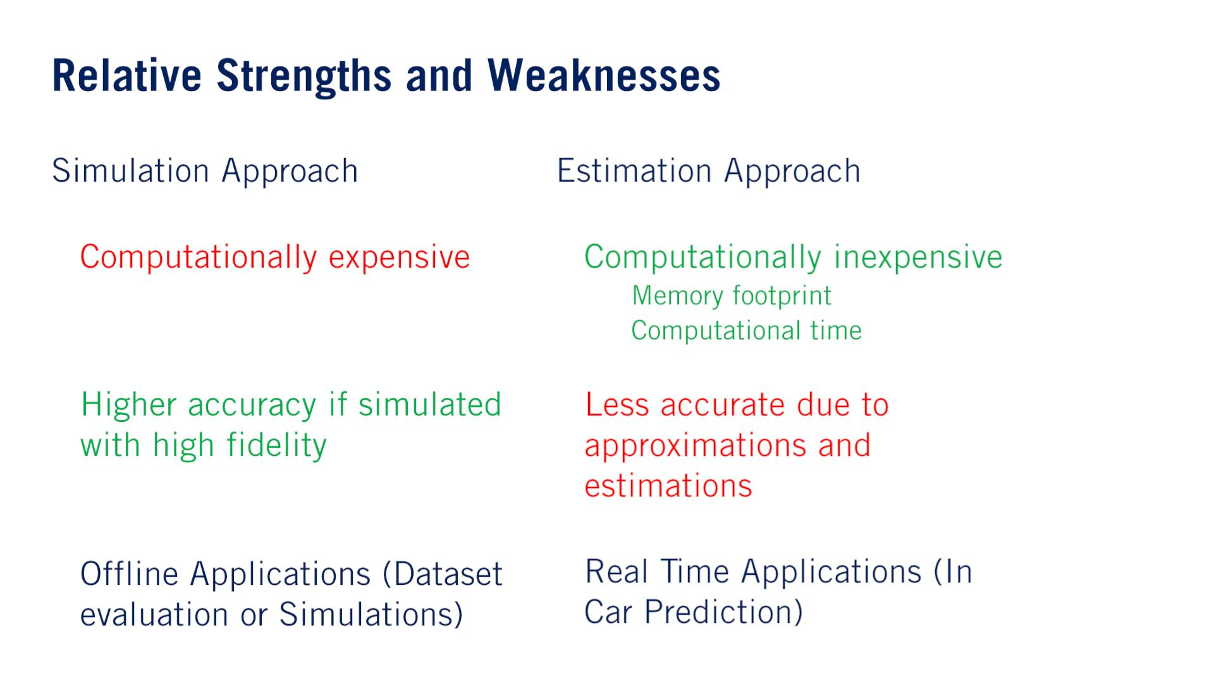
•
•
•
•
o
o
•
•

Slide 32
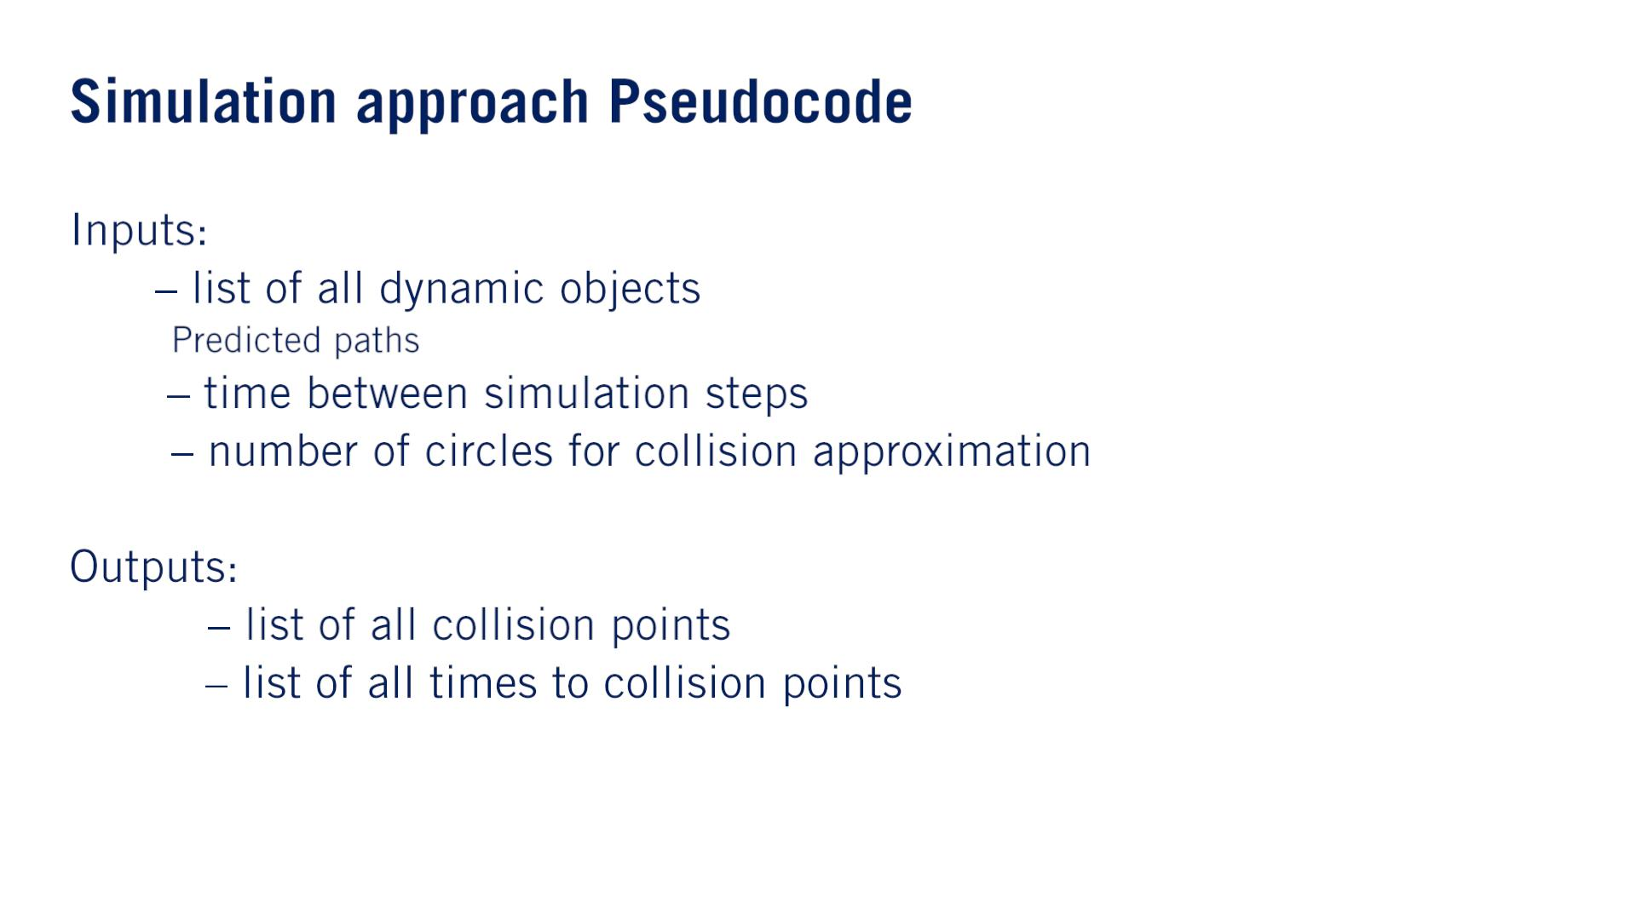
Note that the simulation time steps can be a different size than the predicted path time steps, to improve collision checking approximation accuracy.
• 퐷
o
including the planned path for ego vehicle.
• 푑푡
• 푁_{푐}
circle checking.
and their spacing relative to the object position.
今ADSTの衝突判定はpolygon intersectionでしょう。
• 푃_{푐표푙푙}
• 푇푇퐶

Slide 33
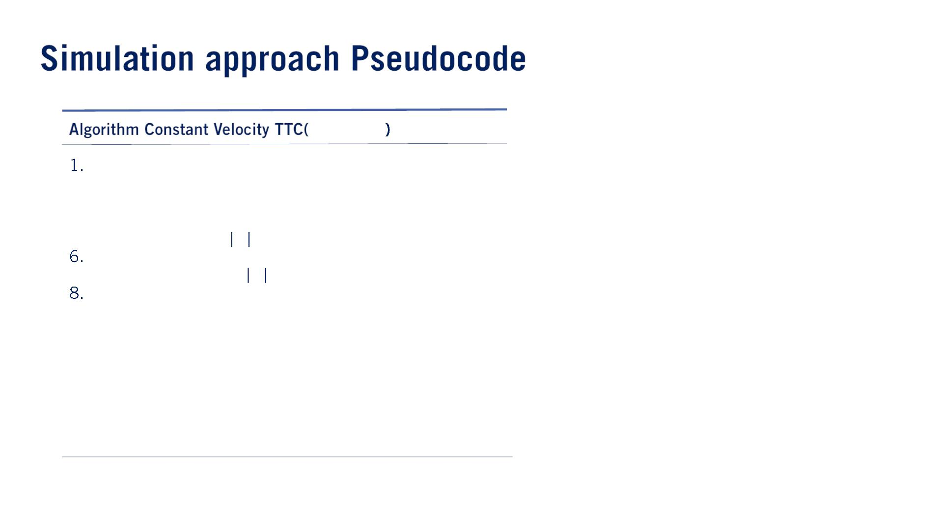
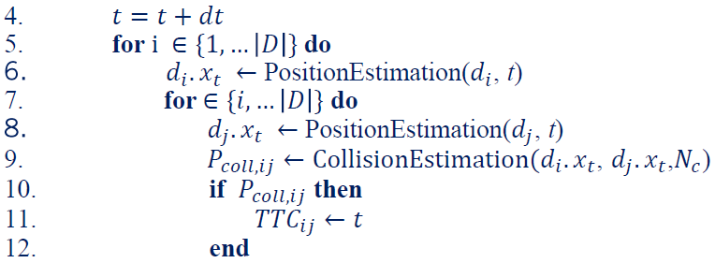
The algorithm loops through each time step from the current time to the end of the simulation horizon, which can’t exceed the maximum length of the predicted and planned path.
퐷, 푇, 푑푡, 푁_{푐}
푡 ← 0
2.
3.
4.
5.
푥₀ = 푥_{표푏푗}
퐰퐡퐢퐥퐞 푡 < 푇 퐝퐨
10.
11.
12.
13.
14.
end
end
15. end while
16. return 푃_{풄}, 푇푇퐶

Slide 34
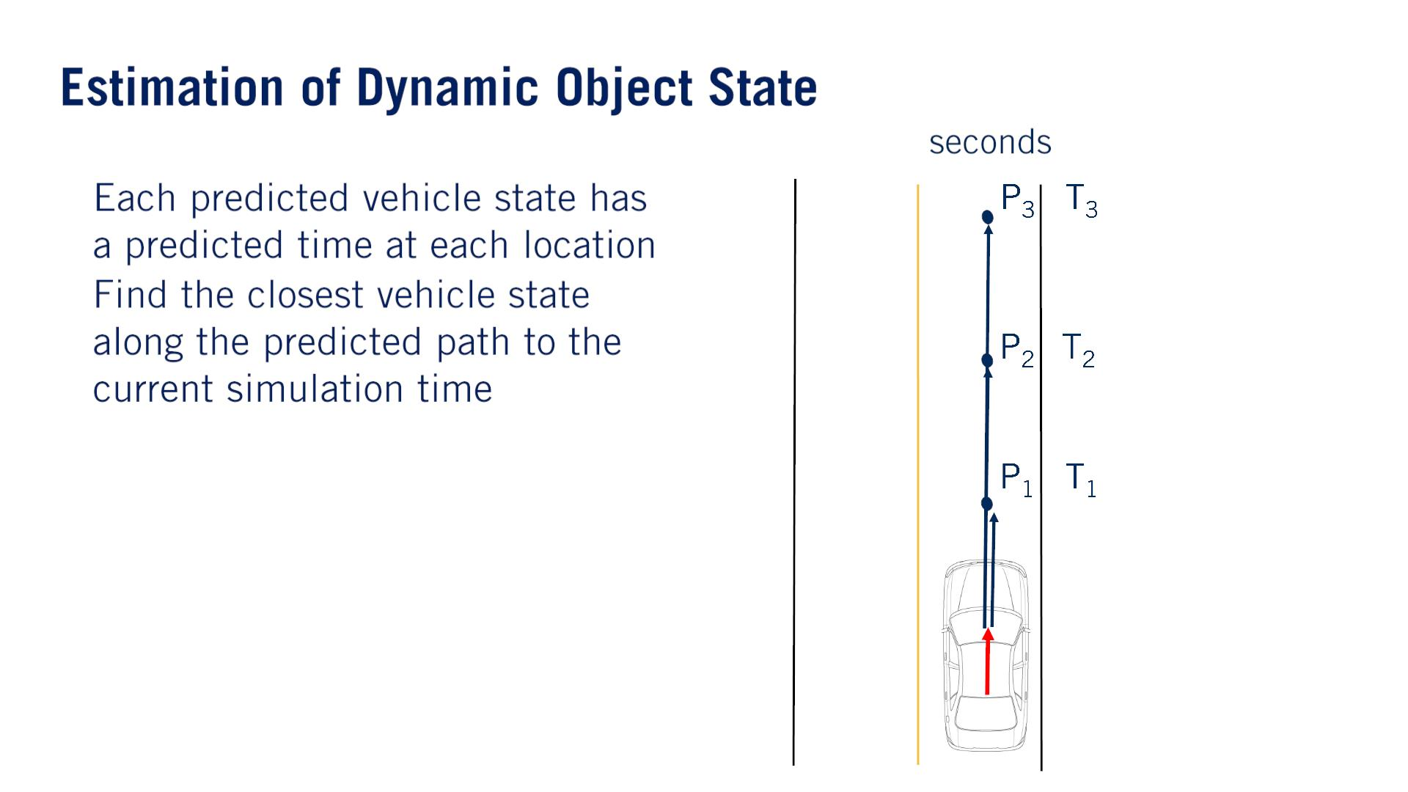
PositionEstimation関数の実現
푇 = 3
•
•
For state prediction, we must take into account the possibility that the predicted path state time steps, do not align with the simulation time steps.
Thus to get the best estimate of a given dynamic object vehicle state at a point in time required by the simulation, we find the closest state preceding the current simulated time, either by looping through each object’s predicted path, or by tracking the current predicted path reference states throughout the simulation loop.
We then apply the predicted inputs for the remaining interval of time to arrive at a prediction of the object location, at the current simulation time. Inputsの意味はよく分かっていない。
何となく内挿見たい

Slide 35
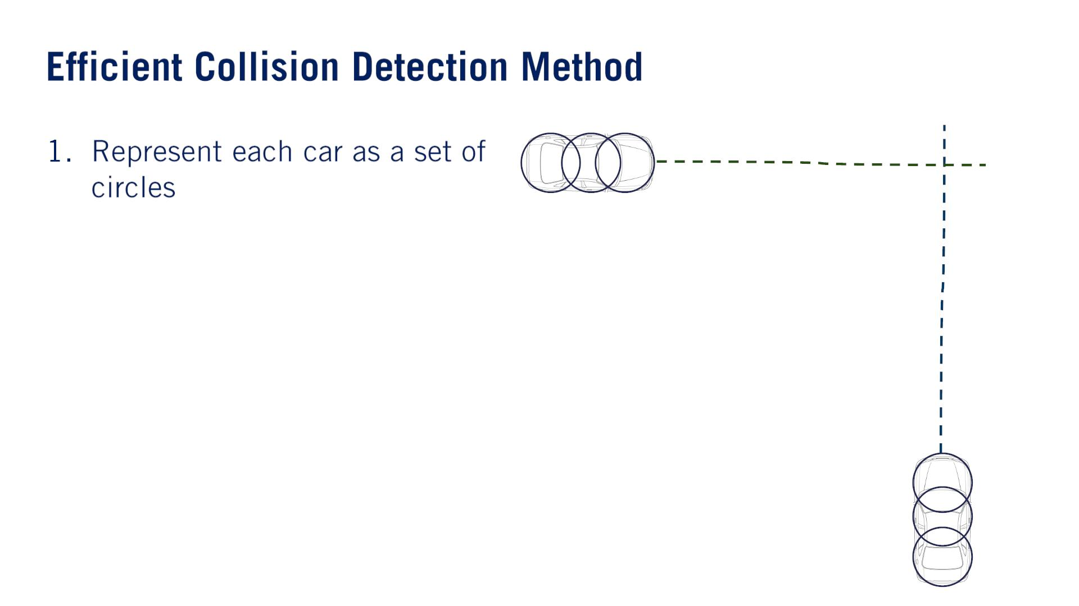
- For the exact approach, a polygonal intersection is performed and any overlap implies a collision.
- Circle approximation.
CollisionEstimation関数の実現
Which leads to 9 distance checks for 3 circle approximation, and 16 distance checks for 4 circle approximation.
As the number of dynamic objects increases in the scene, the number of collision checks scales quadratically, if exhaustively evaluating all possible collisions.
対策：Only compare the ego vehicle to others, to keep computational complexity linear, or eliminate large portions of the pairwise comparisons based on a single point-to-point distance check between the centroids.

Slide 36
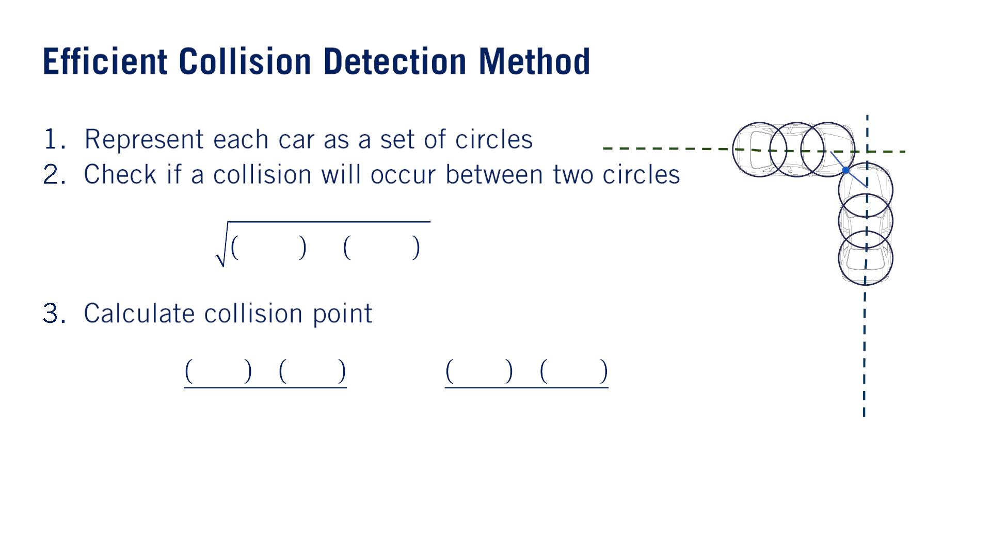
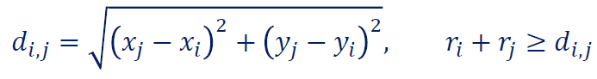
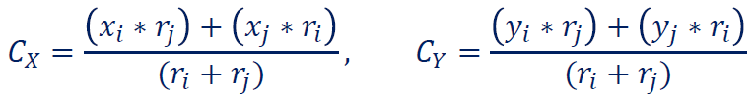
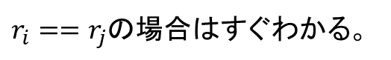
푟_{푖}
푟_{푗}
$r_{i}==r_{j}$の場合はすぐわかる。

Slide 37
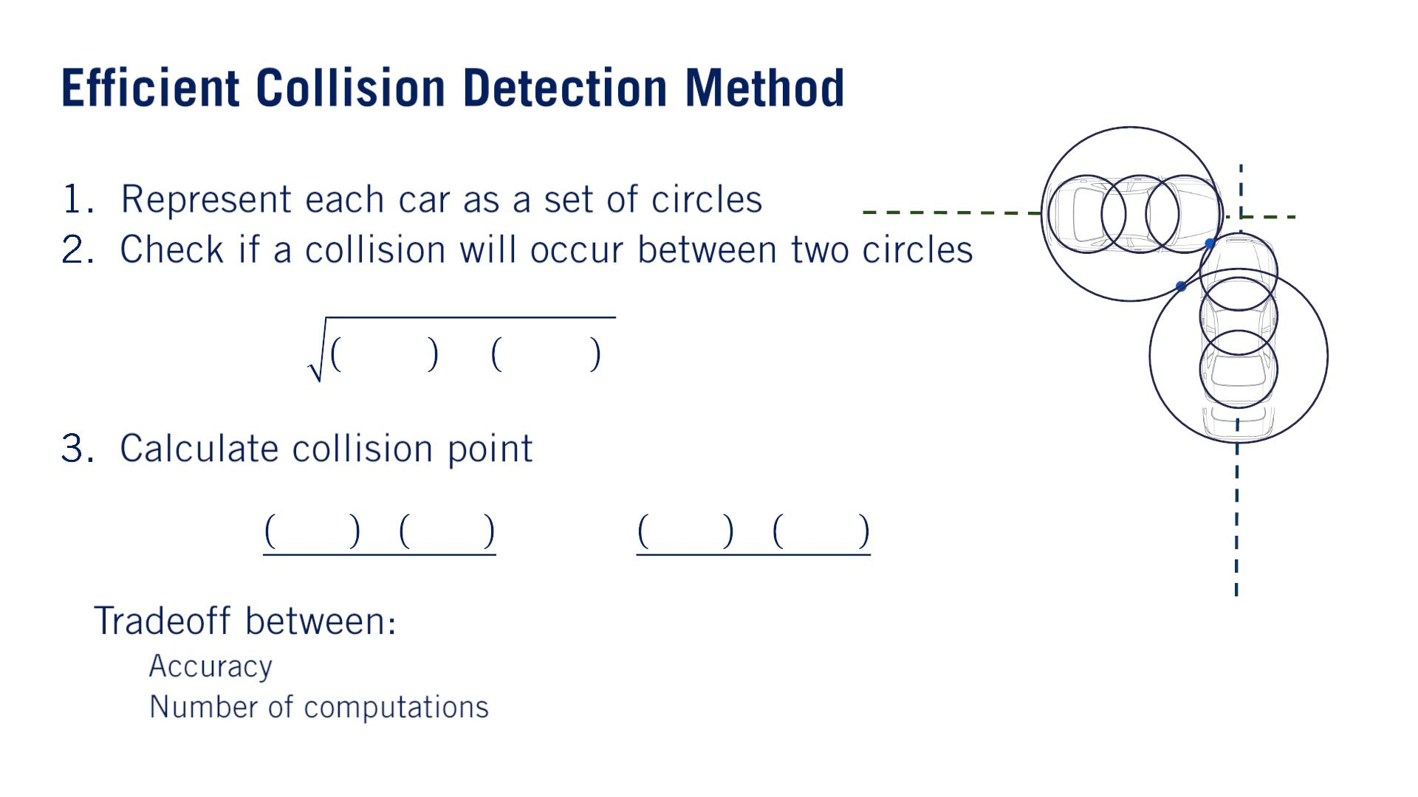
•
o
o

Slide 38
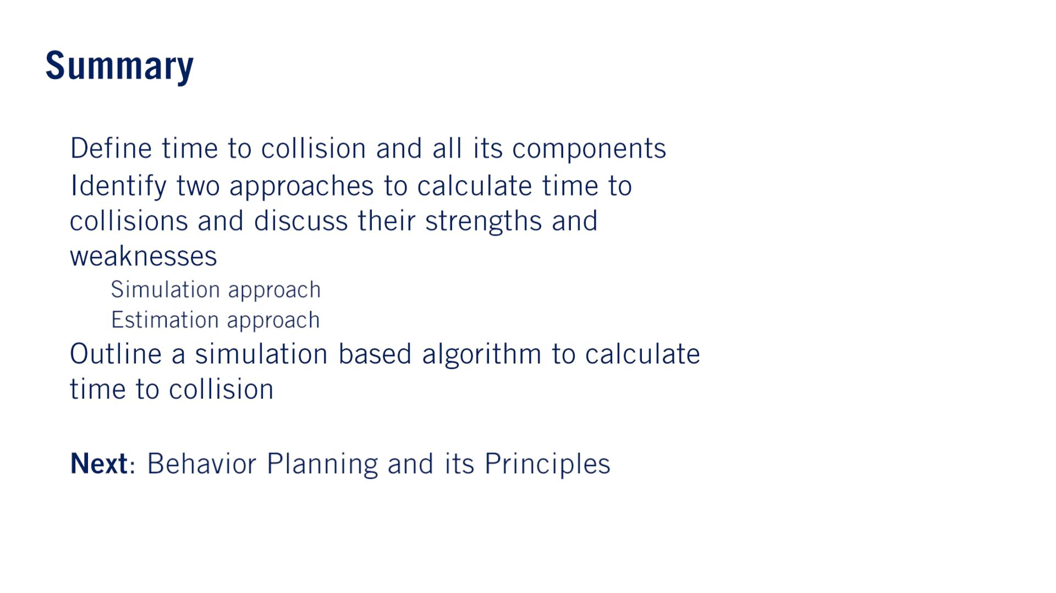
•
•
o
o
•
•

